Slide 1
The True Cost of Medical Billing: In-House vs. Outsourcing
For medical practice administrators and physicians, deciding between in-house billing and outsourcing to a professional billing company represents a significant financial decision with far-reaching implications. While handling billing internally might initially appear more cost-effective, a comprehensive analysis often reveals surprising insights.
This presentation examines the complete financial picture of both approaches, helping you make an evidence-based decision that aligns with your practice's goals, resources, and growth trajectory.
kW
by Kimberly Wiethoff

Slide 2
Understanding the Complete Cost Structure
Direct Costs
Salaries, software, training
Opportunity Costs
Management time, delayed payments
Risk Costs
Errors, compliance issues, audits
When evaluating medical billing options, it's crucial to consider the complete cost structure beyond the obvious expenses. Direct costs like staff salaries and software represent only the visible portion of your investment.
Opportunity costs—including management time diverted from patient care and revenue delayed by inefficient processes—can significantly impact your bottom line. Additionally, risk costs from potential errors, compliance violations, and subsequent audits pose financial threats that are often overlooked in initial assessments.

Slide 3
In-House Billing: The Visible Expenses
Staffing Costs
Technology Investment
Training & Management
$45K-$70K per billing professional annually, plus benefits (15-30% of salary), paid time off, and potential turnover costs (1.5-2x annual salary)
Medical billing software ($5K-$15K initial investment plus annual fees), clearinghouse fees ($1K-$3K annually), hardware upgrades, and maintenance costs
Ongoing education for coding updates ($1K-$2K per employee annually), management oversight time, performance tracking, and workflow optimization
In-house billing requires substantial upfront and ongoing investments. Beyond the significant staff compensation packages, practices must maintain current technology systems and provide continuous professional development to keep pace with evolving billing requirements.
These visible expenses create a substantial financial foundation before a single claim is processed, highlighting the importance of achieving sufficient claim volume and collection rates to justify the fixed cost structure.

Slide 4
In-House Billing: The Hidden Costs
Delayed Revenue Cycles
Coding Errors & Denials
Compliance Vulnerabilities
In-house teams typically process claims in batches, leading to inconsistent submission patterns and extended revenue cycles of 45-60 days compared to industry benchmarks of 30-35 days
Internal staff average 5-15% claim rejection rates versus 2-4% with specialized billing companies, resulting in rework expenses and permanent revenue loss
Limited resources for staying current with regulatory changes increases risk exposure, with potential penalties reaching $50,000 per violation under HIPAA
The invisible costs of in-house billing often exceed the visible expenses. When staff members are overwhelmed, claim submission becomes inconsistent, extending the revenue cycle and constraining cash flow. Additionally, coding errors that slip through can result in denials that are never resolved, creating permanent revenue leakage.
Most concerning is the compliance risk factor—practices with limited resources struggle to maintain comprehensive regulatory awareness, potentially exposing themselves to significant financial penalties and reputational damage.

Slide 5
Staffing Realities: The Practical Challenges
Recruitment
Training
Finding qualified billing specialists in competitive healthcare job market
3-6 month learning curve before peak productivity
Turnover
Performance
High industry turnover rate of 20-30% annually
Variability in output and quality between team members
Beyond the financial implications, in-house billing presents significant operational challenges. The current healthcare staffing shortage has intensified competition for qualified billing specialists, extending hiring timelines and increasing compensation requirements.
Once hired, staff require substantial training investments before reaching optimal productivity. Even well-established teams face inevitable personnel changes, with the billing sector experiencing turnover rates among the highest in healthcare administration. Each departure triggers a costly cycle of recruitment, training, and productivity gaps.

Slide 6
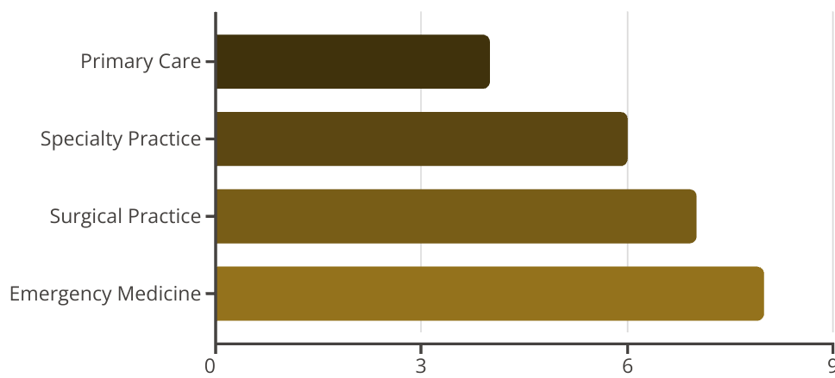
Outsourced Billing: The Fee Structure
Outsourced billing companies typically operate on a percentage-of-collections model, with fees ranging from 4-8% depending on practice specialty, claim volume, and complexity. This structure creates built-in accountability—the billing company only gets paid when you get paid.
Primary care practices generally secure the lowest rates due to higher claim volume and relatively straightforward coding, while specialties with complex procedures and higher reimbursement rates command higher percentages. Most agreements include performance guarantees for key metrics like days in A/R and first-pass acceptance rates, ensuring alignment with practice financial goals.

Slide 7
Outsourced Billing: What You're Really Purchasing
Team of Specialists
Advanced Technology
Risk Mitigation
Economies of Scale
Compliance monitoring, audit protection, and regulatory updates that reduce practice liability and financial exposure
Access to certified coders, denial specialists, payer relationship managers, and compliance experts—expertise that would cost $250K+ annually to replicate in-house
Enterprise-grade billing platforms with machine learning, automated workflow tools, and real-time analytics dashboards that typically require $50K-$100K investments
Leveraging systems and processes refined across multiple practices, delivering efficiencies impossible to achieve independently
The percentage fee for outsourced billing represents more than just claims processing—it's essentially renting a comprehensive revenue cycle management infrastructure. Behind each claim submission is a team of specialists with expertise across multiple payer systems and specialties.
The technology component alone would require substantial capital investment to replicate, including analytics platforms that provide real-time visibility into practice performance. Additionally, billing companies absorb significant compliance responsibility, reducing practice risk exposure while maintaining cash flow continuity regardless of staff absences.

Slide 8
Comparing Key Performance Metrics
Performance Metric
Typical In-House
Industry Leading Outsourced
Days in Accounts Receivable
45-60 days
28-35 days
First-Pass Clean Claim Rate
70-85%
95-98%
Net Collection Rate
85-92%
96-99%
Denial Rate
5-15%
2-4%
Denial Resolution Rate
40-60%
85-95%
When evaluating billing options, key performance indicators provide objective comparison points. Days in A/R—the time between service and payment—directly impacts cash flow, with outsourced solutions typically reducing waiting periods by 2-3 weeks through consistent claim submission and follow-up protocols.
First-pass clean claim rates reflect initial submission quality, with specialized billing companies achieving rates up to 15% higher than in-house teams. Most significantly, net collection rates demonstrate what percentage of legitimate charges convert to actual revenue. The difference between 90% and 97% collection rates on $1M in charges represents $70,000 in additional annual revenue.

Slide 9
Comparative Financial Analysis
In-House Model: $1M Practice
Outsourced Model: $1M Practice
1 FTE Biller: $55,000 + 25% benefits
Percentage Fee: 6% of collections
Software/Clearinghouse: $12,000
Net Collection Rate: 97%
Training/Management: $8,000
Total Charges: $1,000,000
Net Collection Rate: 89%
Total Collections: $970,000
Total Charges: $1,000,000
Total Cost: $58,200 (6% of collections)
Total Collections: $890,000
Additional Revenue: $80,000
Total Cost: $88,750 (10.0% of collections)
Net Benefit: $110,550 (cost savings + increased revenue)
This analysis demonstrates how outsourced billing can deliver superior financial outcomes despite the percentage fee structure. For a practice with $1M in charges, the 8% improvement in collection rate generates $80,000 in additional revenue that would otherwise be lost to write-offs, denials, and underpayments.
When combined with the $30,550 in direct cost savings from eliminating in-house expenses, the total financial benefit reaches $110,550—effectively transforming billing from a cost center to a revenue enhancement strategy. Larger practices often realize even greater economies of scale, with the gap between models widening as charge volume increases.

Slide 10
Ideal Candidates for Outsourcing
New Practices
Avoid capital expenditure and staffing challenges while establishing predictable cash flow during critical growth phase
Growing Practices
Maintain scalability without staffing disruptions as patient volume increases
Struggling Practices
Address declining collections, rising A/R, and cash flow constraints with immediate performance improvement
Multi-Provider Groups
Leverage sophisticated analytics and standardized processes across locations
While outsourced billing can benefit most practices, certain scenarios present particularly compelling use cases. New practices can avoid the substantial startup investment in billing infrastructure and personnel, allowing physicians to focus capital on clinical capabilities while maintaining consistent cash flow during the establishment phase.
Practices experiencing growth inflection points often find in-house billing teams struggling to scale efficiently, leading to backlogs and revenue delays. Similarly, practices with declining financial performance can leverage outsourcing as an immediate intervention to stabilize revenue. Multi-provider groups benefit from standardized processes and comprehensive analytics that optimize reimbursement across the organization.

Slide 11
Implementation & Transition Considerations
Contract & Planning
Parallel Processing
2-3 weeks: Establish performance guarantees, data sharing protocols, and transition timeline
4-6 weeks: Process new claims through outsourced system while resolving existing A/R
System Integration
Full Transition
3-4 weeks: Configure EMR integration, establish secure data transfers, and test interfaces
60-90 days: Complete handoff of all billing functions and optimization of workflow
Transitioning to outsourced billing requires careful planning but follows a well-established process with predictable milestones. The initial contract phase should include detailed performance guarantees and clearly defined responsibilities. System integration follows, connecting your EMR system directly with the billing company's platform through secure channels.
Most transitions implement a parallel processing period where new claims flow through the outsourced system while the existing accounts receivable is either transferred or worked down. Full transition typically completes within 90 days, with many practices experiencing improved cash flow within the first 30-45 days as clean claims begin processing at higher acceptance rates.

Slide 12
Making the Right Decision for Your Practice
Evaluate Long-Term Strategy
Calculate Total Cost of Ownership
Consider how your chosen billing approach aligns with long-term practice goals, including growth plans, potential mergers or acquisitions, and physician retirement timelines. The right decision balances immediate financial impact with strategic positioning.
Assess Current Performance
Review key metrics including days in A/R, net collection rate, and denial percentages to establish your baseline performance. Request benchmark data from colleagues in similar specialties for comparison.
Develop a comprehensive analysis of all current billing expenses, including direct costs, overhead allocation, and opportunity costs from suboptimal performance. Compare this with proposals from 2-3 reputable billing companies.
The decision between in-house and outsourced billing should be approached as a strategic business analysis rather than simply comparing percentage fees against staff salaries. Begin by honestly assessing your current performance metrics—if you don't track these figures, that itself may indicate an opportunity for improvement.
Most importantly, recognize that this isn't necessarily a permanent decision. Many practices transition between models as their needs evolve. The key is making an informed choice based on complete financial analysis rather than assumptions about which approach is inherently more cost-effective.

