Slide 1
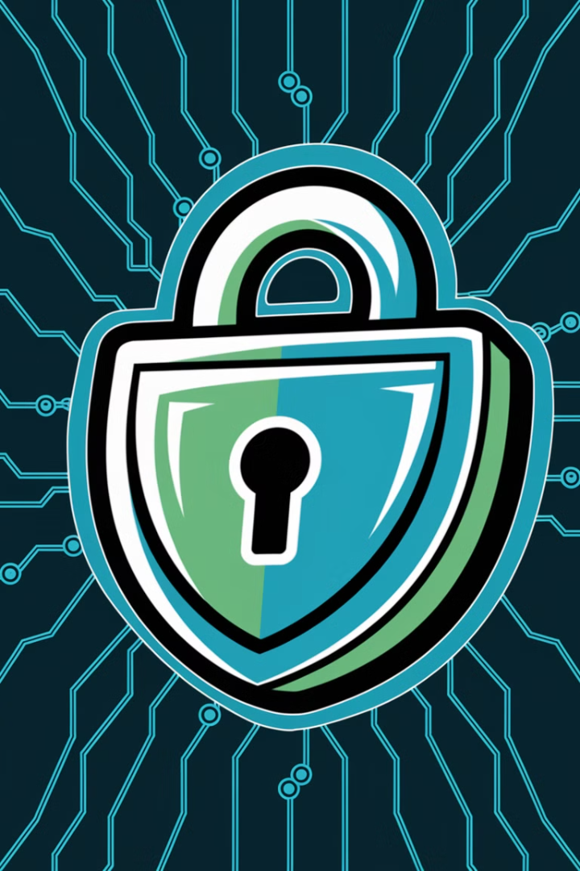
Security Tools: Protecting Your Digital Fortress
In today's digital landscape, cybersecurity is paramount. As cyber threats evolve, organizations must leverage various security tools to protect their networks, systems, and data. This presentation explores five critical security tools: Firewalls, Intrusion Detection and Prevention Systems (IDS/IPS), Security Information and Event Management (SIEM), Encryption Protocols, and Virtual Private Networks (VPNs).
kW
by Kimberly Wiethoff

Slide 2
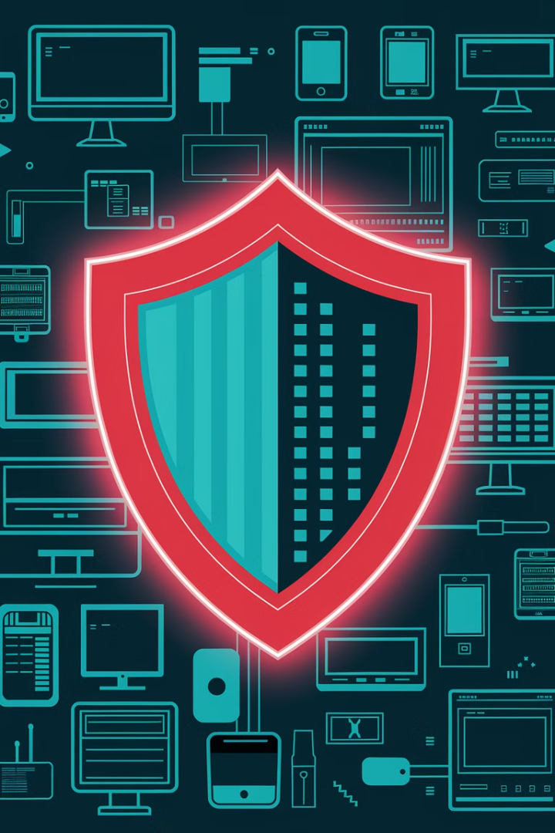
Firewalls: The First Line of Defense
1
Definition
2
Types
A firewall acts as a barrier between a trusted internal network and untrusted external networks, monitoring and controlling incoming and outgoing network traffic based on predetermined security rules.
Packet-Filtering, Stateful Inspection, Proxy, and Next-Generation Firewalls (NGFWs)
3
Importance
Firewalls help prevent unauthorized access, mitigate malware attacks, and enhance overall network security.

Slide 3
Types of Firewalls
Packet-Filtering
Stateful Inspection
Proxy
Examines each packet and permits or blocks it based on predefined rules.
Acts as an intermediary between users and the internet, filtering traffic at the application level.
Tracks the state of active connections and makes decisions based on the context of the traffic.
Next-Generation (NGFW)
Incorporates deep packet inspection, application awareness, and advanced threat intelligence.

Slide 4
Intrusion Detection and Prevention Systems (IDS/IPS)
Intrusion Detection System (IDS)
Intrusion Prevention System (IPS)
Monitors network traffic for suspicious activity and alerts administrators but does not take action.
Monitors traffic like IDS but also takes proactive measures to block or neutralize threats.

Slide 5
IDS/IPS Techniques
Signature-Based Detection
Identifies known attack patterns using a database of signatures. This method is effective against well-known threats but may miss new or modified attacks.
Anomaly-Based Detection
Uses machine learning and behavioral analysis to detect deviations from normal activity. This approach can identify novel threats but may produce false positives.

Slide 6
Security Information and Event Management (SIEM)
Event Correlation
Log Management
1
Identifies patterns and potential threats across different data sources.
Aggregates logs from firewalls, IDS/IPS, servers, and applications.
2
Compliance Reporting
Real-Time Monitoring
4
Provides security teams with dashboards and alerts to detect suspicious activity.
Helps organizations meet regulatory requirements (e.g., GDPR, HIPAA, PCI-DSS).
3

Slide 7
Encryption Protocols: Protecting Data
SSL/TLS
AES
RSA
IPSec
Secures data transmitted over the internet (e.g., HTTPS)
Used for encrypting sensitive data
A public-key encryption system commonly used in digital signatures
Encrypts IP packets for secure network communication

Slide 8
Why Encryption Matters
Data Confidentiality
1
Ensures only authorized parties can access information
Integrity Protection
2
Detects any unauthorized changes to data
Authentication
3
Verifies the identity of communicating parties
Non-repudiation
4
Prevents denial of actions or transactions

Slide 9
Virtual Private Networks (VPNs)
Remote Access VPN
Site-to-Site VPN
Allows individuals to securely connect to a private network from a remote location, ensuring safe access for remote workers.
Connects multiple networks securely over the internet, ideal for businesses with multiple locations or international connections.

Slide 10
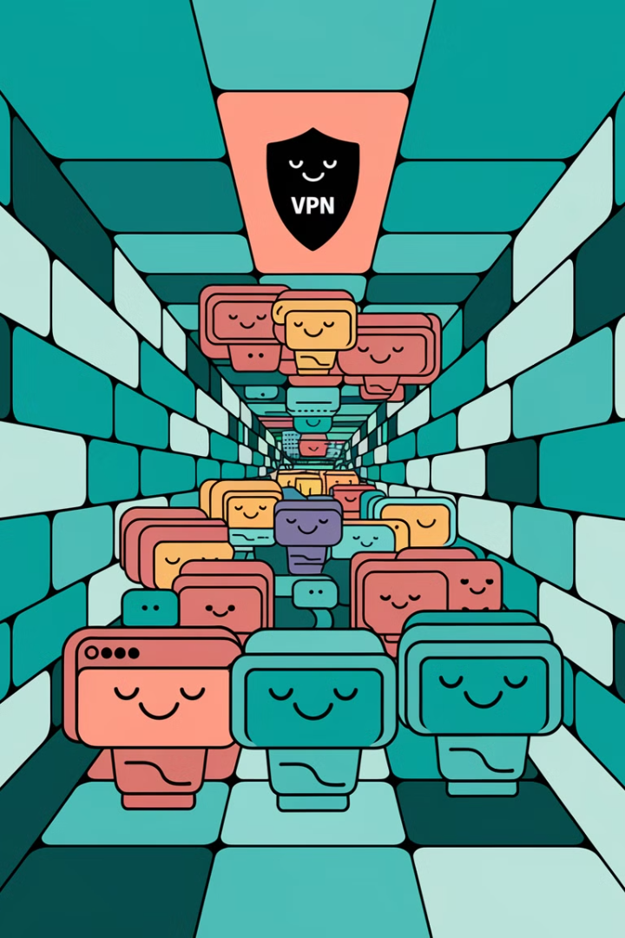
VPN Security Features
Encryption
Tunneling Protocols
Anonymity and Privacy
Protects data in transit, ensuring confidentiality over public networks.
Such as OpenVPN, L2TP/IPSec, and WireGuard, providing secure data transmission.
Masks IP addresses to enhance online privacy and protect user identity.

Slide 11
Multi-Layered Security Strategy
Firewalls
1
First line of defense
IDS/IPS
2
Threat detection and prevention
SIEM
3
Centralized security monitoring
Encryption
4
Data protection
VPNs
5
Secure remote access

Slide 12
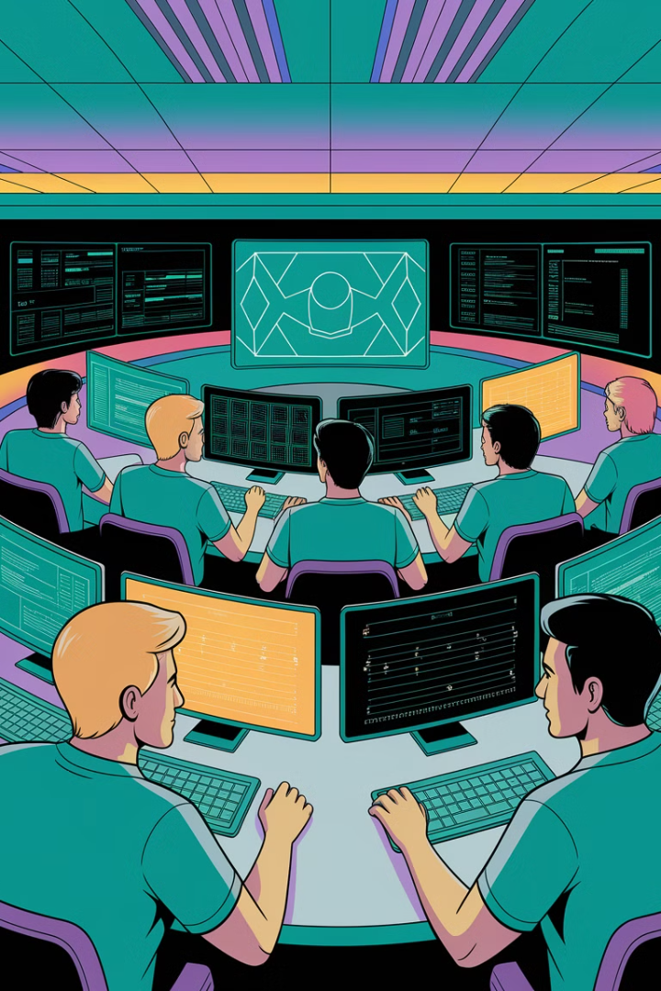
Conclusion: Fortifying Your Digital Defenses
Comprehensive Protection
Evolving Threats
As cyber threats become more sophisticated, organizations must continually adapt and update their security measures to stay protected.
Implementing a multi-layered security strategy with firewalls, IDS/IPS, SIEM, encryption, and VPNs significantly reduces the risk of cyberattacks and data breaches.
Ongoing Vigilance
Regular security audits, employee training, and staying informed about the latest threats are crucial for maintaining a strong security posture.

