Slide 1
Winning Strategies for IT Job Seekers
Navigating the competitive IT job market demands a strategic approach. This presentation outlines essential strategies to help you stand out and land your dream job.
kW
by Kimberly Wiethoff

Slide 2
Tailor Your Applications
Target Your Resume
Craft a Compelling Cover Letter
Customize your resume for each job. Highlight specific technical skills, certifications, and projects relevant to the role.
Showcase your passion and qualifications. Address the employer's needs and explain how your skills and experience align with the position.

Slide 3
Leverage Your Network
Attend Industry Events
Engage on LinkedIn
Join professional groups, participate in discussions, and connect with industry leaders.
Meetups, conferences, and career fairs provide valuable networking opportunities.
Reach Out to Former Colleagues
Tap into your existing network for potential leads and referrals.

Slide 4
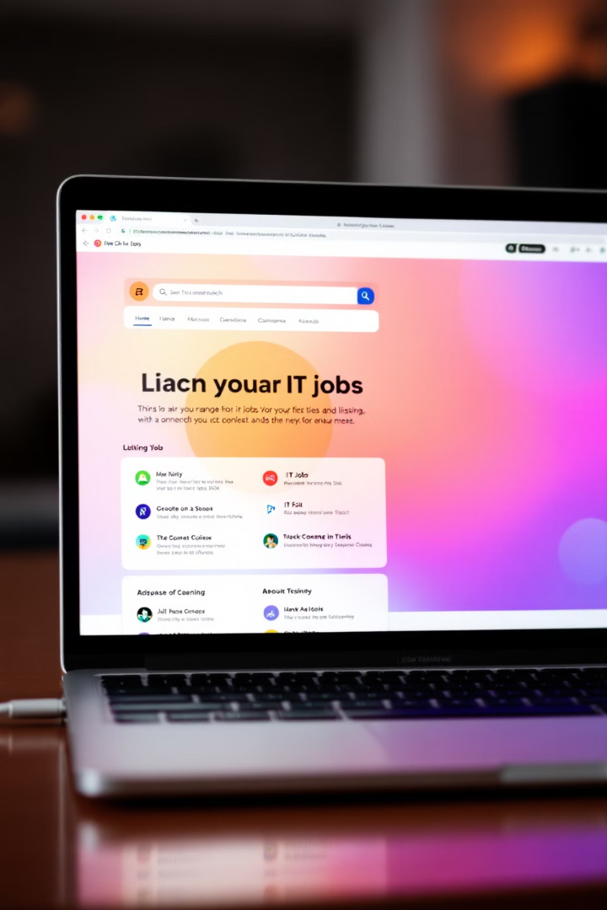
Utilize Specialized Job Boards
Dice
Hired
A leading platform for IT professionals, featuring a wide array of tech roles.
Connects talented individuals with top tech companies, offering a streamlined application process.
Stack Overflow
A popular community for developers, where employers post specific coding challenges and projects.

Slide 5
Invest in Continuous Learning
Pursuing Certifications
Enrolling in Online Courses
Demonstrate your expertise and commitment to professional development.
Stay ahead of the curve by mastering in-demand skills and technologies.
Attending Workshops
Gain hands-on experience and network with industry professionals.

Slide 6
Optimize Your Online Presence
1
Professional Profile Picture
A clear and professional photo enhances your credibility.
2
Compelling Summary
Highlight your key skills, experience, and career aspirations.
3
Showcase Your Work
Present projects, articles, or contributions to demonstrate your abilities.
4
Engage with Industry Content
Share relevant articles, participate in discussions, and establish yourself as a thought leader.

Slide 7
Prepare for Technical Interviews
Brush Up on Coding Challenges
Practice algorithms, data structures, and system design concepts.
Refine Your Communication Skills
Practice explaining complex technical concepts in a clear and concise manner.
Develop Soft Skills
Highlight your teamwork, communication, and problem-solving abilities.

Slide 8
Final Thoughts: Be Persistent and Proactive
Landing your dream IT job takes effort and dedication. By following these strategies and remaining persistent, you can set yourself up for success in the exciting tech industry.

