Slide 1
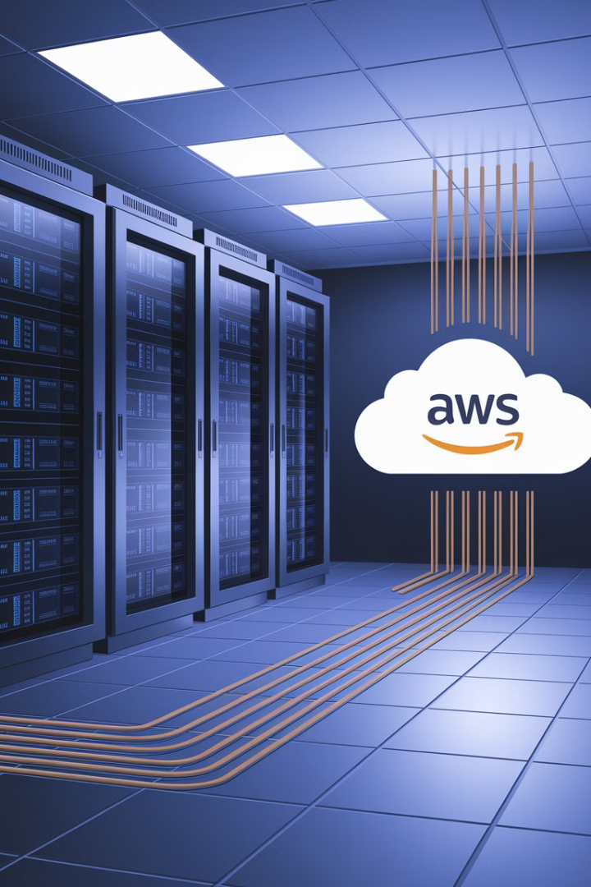
Migrating to AWS: Project Manager's Guide to a Successful Cloud Migration
Cloud migration is no longer just an IT decision - it's a business transformation. As organizations embrace the Amazon Web Services (AWS) cloud, project managers are on the front lines, ensuring that migrations are delivered on time, within budget, and with minimal disruption.
But here's the catch: Cloud migrations are complex.
❌ Missed dependencies can cause outages.
❌ Uncontrolled costs can lead to budget overruns.
❌ Poor planning can delay business operations.
kW
by Kimberly Wiethoff

Slide 2
Understanding the AWS Migration Framework
1
Rehost (Lift & Shift)
2
Replatform (Lift, Tinker & Shift)
3
Repurchase (Drop & Shop)
Moving applications as-is to AWS with minimal changes. This approach offers the quickest migration path with lower initial complexity.
Replacing existing software with cloud-based SaaS solutions, like moving from on-premises CRM to Salesforce. This eliminates maintenance of legacy systems.
Making small optimizations while migrating, such as switching databases to AWS RDS. This balances speed with some cloud optimization benefits.

Slide 3
More Migration Strategies
Refactor (Re-architecting)
Retain
Keeping certain applications on-premises due to compliance, technical constraints, or business requirements. This hybrid approach acknowledges that not everything belongs in the cloud.
Modernizing applications to be cloud-native, such as moving from monolithic to microservices architecture. This approach maximizes cloud benefits but requires more time and resources.
Retire
Decommissioning outdated applications that are no longer needed. This strategy reduces your migration scope and eliminates unnecessary costs.

Slide 4
Cloud Migration Assessment Phase
1
Application Discovery
Identify all applications, databases, and dependencies in your current environment. Create a comprehensive inventory to ensure nothing is missed during migration.
2
TCO Analysis
Perform a Total Cost of Ownership (TCO) analysis comparing current costs to projected AWS expenses. This helps build the business case for migration.
3
AWS Service Mapping
Determine which AWS services (EC2, RDS, Lambda, etc.) will replace current infrastructure components. Match application requirements to appropriate cloud services.
4
Compliance Review
Address compliance and security requirements early to avoid roadblocks later. Identify any regulatory constraints that might affect your migration approach.

Slide 5
Migration Planning Phase
Proof of Concept
Stakeholder Alignment
Conduct a proof of concept (PoC) before full migration to validate your approach and identify potential issues early in the process.
Resource Planning
Align stakeholders on expectations and business impact. Communicate potential disruptions and ensure business units are prepared for changes.
Strategy Selection
Establish a timeline, budget, and resource plan that accounts for all migration activities. Identify skill gaps and training needs for your team.
Choose the appropriate migration strategy (6Rs) for each system based on business requirements, technical constraints, and long-term goals.

Slide 6
Migration Execution Phase
Batch Migration
Migrate workloads in batches rather than all at once to minimize risk and allow for adjustments between migration waves.
Migration Tools
Implement AWS CloudEndure Migration or AWS DataSync to automate and streamline the migration process for different workload types.
Testing
Test applications thoroughly before switching to production to ensure functionality, performance, and security meet requirements in the new environment.
Cutover
Execute the transition from on-premises to AWS with minimal downtime using detailed cutover plans and rollback procedures if issues arise.

Slide 7
Optimization & Monitoring Phase
Performance Tuning
Cost Optimization
Fine-tune AWS resources for optimal performance based on actual usage patterns.
1
Implement AWS cost management best practices to eliminate waste and maximize value.
2
Team Training
Security Enhancement
4
Develop internal expertise on AWS operations and maintenance to ensure long-term success.
Continuously improve security posture using AWS native tools and third-party solutions.
3
Set clear KPIs (e.g., uptime, performance improvements, cost savings) to measure migration success and demonstrate business value. Implement CloudWatch & GuardDuty for comprehensive monitoring of your AWS environment.

Slide 8
Managing AWS Migration Costs
Rightsize EC2 Instances
Use AWS Cost Explorer
Leverage AWS Savings Plans
Set Up Cost Alerts
Avoid over-provisioning by selecting the right instance types based on actual workload requirements. Regularly review and adjust instance sizes as needs change.
Track real-time cloud expenses with detailed visibility into service usage. Set up custom reports to identify cost drivers and optimization opportunities.
Avoid bill shock by defining budget thresholds and receiving notifications when spending approaches limits. This enables proactive cost management.
Get significant discounts for predictable workloads by committing to consistent usage over 1-3 year terms. This can reduce costs by up to 72% compared to on-demand pricing.

Slide 9
Security & Compliance in Cloud Migrations
Security Monitoring
Data Protection
Enable AWS GuardDuty, Inspector, and CloudTrail for comprehensive security monitoring and threat detection across your AWS environment.
Identity & Access Management
Encrypt data at rest using AWS KMS and in transit using TLS. Implement proper backup and recovery procedures to protect against data loss.
Use AWS IAM to enforce least privilege access principles. Implement role-based access controls and regularly audit permissions to prevent unauthorized access.
Compliance Framework
Ensure adherence to relevant regulations like HIPAA, GDPR, SOC 2, ISO 27001 by leveraging AWS compliance programs and documentation.
2
3
1
4

Slide 10
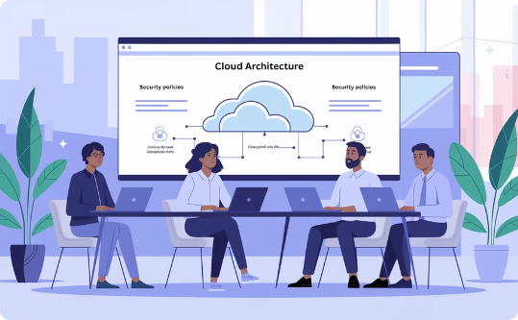
Team Collaboration in Cloud Migrations
Infrastructure & Cloud Engineers
Application Teams
Security & Compliance
Development teams handle refactoring or rehosting applications for the cloud. They adapt code to work efficiently in AWS and take advantage of cloud-native features.
These experts ensure cloud security policies are implemented correctly and that the migration maintains compliance with relevant regulations and standards.
These specialists are responsible for setting up AWS environments, configuring networking, and ensuring the technical foundation is solid. They translate on-premises architecture to cloud-native designs.

Slide 11
Agile & DevOps in Cloud Migrations
Agile Sprints
1
Use iterative approaches for phased migration
CI/CD Pipelines
2
Implement automated deployment workflows
Infrastructure as Code
3
Manage AWS resources programmatically
Rather than attempting a "big bang" migration, break the work into Agile sprints with clear deliverables. This allows for continuous adjustment and risk management throughout the process.
Implement CI/CD pipelines using AWS CodePipeline or Jenkins to automate deployments and ensure consistency. Leverage Infrastructure as Code (IaC) with tools like Terraform or CloudFormation to maintain environment consistency and enable version control of infrastructure.

Slide 12
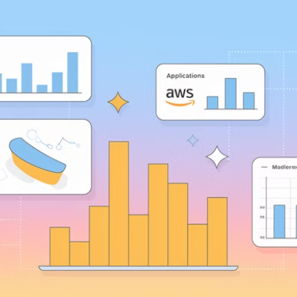
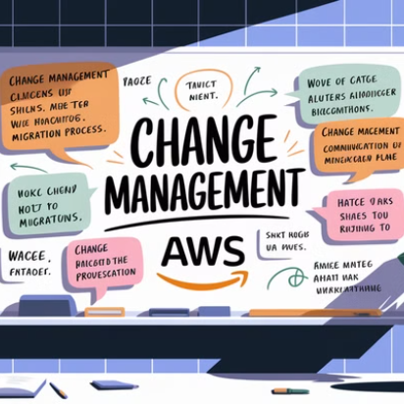
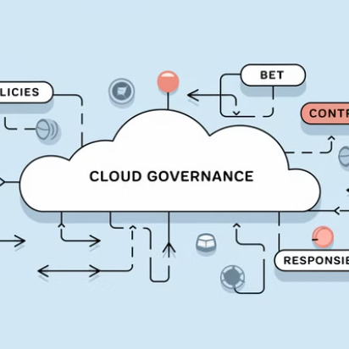
Communication & Governance
Regular stand-ups, sprint reviews, and retrospectives help manage risks and dependencies effectively. Establish clear communication channels between technical teams and business stakeholders to maintain alignment throughout the migration journey.
Implement a cloud governance framework that defines policies, controls, and responsibilities for AWS resource management. This ensures consistent application of best practices and compliance requirements across all migrated workloads.

Slide 13
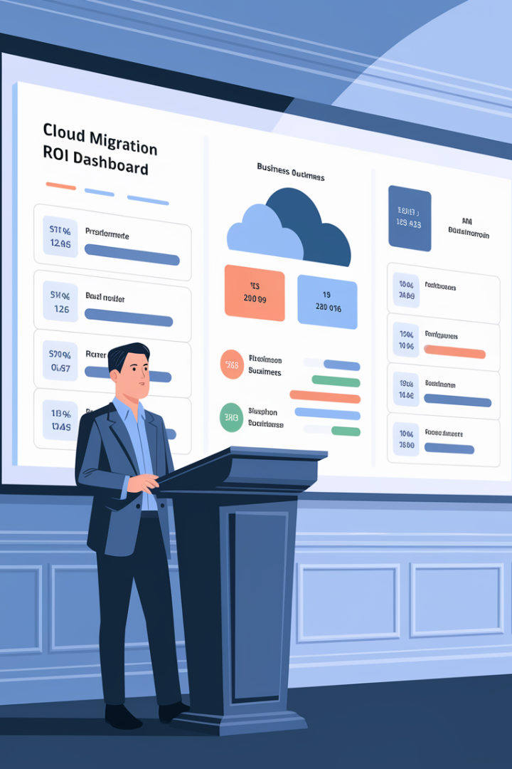
Measuring Migration Success
99.99%
Uptime
Target availability for critical applications after migration
30%
Cost Reduction
Average infrastructure cost savings after optimization
40%
Deployment Speed
Improvement in application deployment time
50%
Resource Efficiency
Reduction in underutilized infrastructure
Define clear success metrics before migration begins to objectively measure outcomes. Technical KPIs should align with business objectives to demonstrate the value of cloud migration beyond infrastructure changes.
Conduct regular reviews of these metrics after migration to identify further optimization opportunities and ensure the migration delivers the expected business benefits.

Slide 14
Leading a Cloud Migration Successfully
Business Transformation
1
Align with strategic goals
Cross-Functional Collaboration
2
Unite diverse teams
Strategic Planning
3
Define clear roadmap
Technical Excellence
4
Ensure best practices
Risk Management
5
Mitigate potential issues
A successful AWS migration is not just about technology—it's about strategic planning, risk management, and cross-functional collaboration. Project managers must balance technical considerations with business objectives to deliver meaningful transformation.
By following a structured approach—defining migration strategies, creating realistic roadmaps, controlling costs, prioritizing security, and fostering collaboration—PMs can lead their organizations to cloud success and unlock the full potential of AWS.

Slide 15
Final Thoughts
A successful AWS migration is not just about technology—it’s about strategic planning, risk management, and cross-functional collaboration.
Define a migration strategy (Rehost, Replatform, Refactor, etc.).
Create a realistic migration roadmap with phased execution.
Control AWS costs with budget monitoring and right-sizing.
Prioritize security and compliance to avoid risks.
Foster Agile & DevOps collaboration for seamless execution.

