Slide 1
Roles and Responsibilities in Lean Agile
Lean Agile thrives on collaboration, transparency, and streamlined processes. Distinct roles with clear responsibilities are essential for success. This presentation outlines key roles and their unique contributions.
kW
by Kimberly Wiethoff

Slide 2
Product Owner: The Value Champion
Define and Prioritize Backlog
Customer Advocacy
Ensure team works on high-priority tasks aligned with business goals.
Represent customer perspective and communicate value of deliverables.
Stakeholder Collaboration
Define Success Criteria
Gather requirements, align priorities, and communicate progress.
Set acceptance criteria and validate deliverables against them.

Slide 3
Project Manager: The Coordinator
Scope Management
Risk Management
Align projects with organizational goals and define deliverables clearly.
Identify potential risks and develop mitigation strategies.
Resource Coordination
Reporting
Ensure teams have necessary resources and support.
Provide stakeholders with updates on progress, budgets, and risks.

Slide 4
Scrum Master: The Agile Coach
1
Facilitate Scrum Ceremonies
Organize daily stand-ups, sprint planning, reviews, and retrospectives.
2
Remove Impediments
Identify and eliminate roadblocks hindering team progress.
3
Coach and Mentor
Educate on Agile principles, Lean practices, and continuous improvement.
4
Protect the Team
Shield from external distractions to maintain focus on sprint goals.

Slide 5
Program Manager: The Strategic Overseer
Portfolio Management
1
Prioritize initiatives and allocate resources across projects.
Alignment with Business Goals
2
Ensure teams contribute to strategic objectives.
Dependency Management
3
Identify and manage dependencies across teams and projects.
Reporting and Governance
4
Provide leadership with high-level updates and risk assessments.

Slide 6
Release Train Engineer: The SAFe Conductor
Facilitate PI Planning
Track Progress
Manage Risks
Drive Improvement
Monitor ART performance, ensuring milestones and objectives are met.
Identify risks across the ART and facilitate mitigation strategies.
Lead ART-level retrospectives to identify improvement opportunities.
Organize and coordinate Program Increment planning sessions.

Slide 7
Team Members: The Value Creators
Deliver Commitments
Ensure Quality
Complete assigned tasks and user stories within sprint timelines.
Meet definition of done and acceptance criteria for deliverables.
Continuous Learning
Collaborate
Stay updated on best practices, tools, and technologies.
Work closely with team members, Product Owners, and Scrum Masters.

Slide 8
Lean Agile Coach: The Transformation Guide
Training and Mentoring
Change Management
Metrics and Insights
Scaling Agile
Help organizations scale Agile practices effectively.
Educate teams and leaders on Lean and Agile principles.
Facilitate cultural and process changes for Lean Agile mindset.
Use data to measure progress and identify improvement areas.

Slide 9
Key Role Differences
Product Owner vs. Scrum Master
Scrum Master vs. RTE
PO focuses on what the team works on. Scrum Master focuses on how the team works.
Scrum Master works at team level. RTE operates at ART level in SAFe environments.
1
2
3
Project Manager vs. Program Manager
PM manages individual projects. Program Manager oversees multiple projects for organizational alignment.

Slide 10
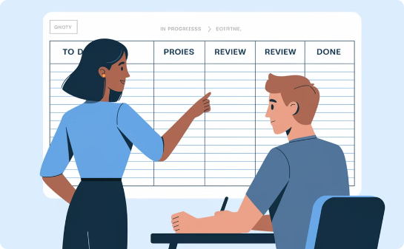
Collaboration in Lean Agile
PO and Scrum Master Synergy
Strategic Alignment
Scaled Coordination
Program and Project Managers ensuring cohesive execution across initiatives.
RTE orchestrating multiple teams for synchronized delivery in SAFe.
Aligning product vision with team execution for optimal value delivery.

Slide 11
Benefits of Clear Roles
Improved Efficiency
1
Clear responsibilities reduce overlap and confusion.
Enhanced Transparency
2
Well-defined roles create accountability and visibility.
Faster Value Delivery
3
Streamlined processes and focused efforts accelerate outcomes.
Better Alignment
4
Roles ensure all efforts contribute to organizational goals.

Slide 12
Conclusion: Roles Drive Lean Agile Success
Clear roles and responsibilities are critical in Lean Agile environments. They drive efficiency, transparency, and value delivery. Understanding core responsibilities helps teams collaborate effectively and align with organizational objectives.

