Slide 1
Leveraging Power Platform with Dynamics CRM
Unlock greater business value by combining Microsoft Dynamics CRM with Power Platform capabilities. This presentation shows how to transform your CRM from a system of record into an engine for automation, analytics, and innovation.
kW
by Kimberly Wiethoff

Slide 2
Power BI: Turning CRM Data into Visual Insights
100%
75%
Real-time Data
Faster Decisions
Live dashboards directly connected to your CRM
Reduced time to insight with visual analytics
60%
User Adoption
Increased engagement with self-service reporting
Transform your treasure trove of customer data into actionable insights. Easy drag-and-drop visuals help non-technical users explore trends independently.

Slide 3
Power Automate: Eliminating Manual Bottlenecks
Trigger Event
New lead created or case opened in CRM
Automated Process
Route approvals, send notifications, update records
Completion
Tasks finished without manual intervention
Eliminate repetitive tasks that slow down your team. Set triggers based on CRM events to route leads, send follow-ups, or escalate cases automatically.

Slide 4
Power Apps: Custom Interfaces Without Heavy Development
Role-specific Apps
Mobile-friendly Forms
Create tailored experiences for field agents, service techs, and sales teams. Show only what each user needs to see.
Build responsive interfaces that work anywhere. Capture data on the go with simplified entry screens.
Rapid Development
Deliver solutions in days or weeks instead of months. Use low-code tools to accelerate your timeline.
Not everyone needs the full CRM interface. Create streamlined, task-specific applications that connect directly to your Dynamics data.

Slide 5
Project Management Advantages
Greater Agility
Adapt workflows as business needs evolve
Higher Satisfaction
Deliver customized experiences for all stakeholders
Faster Delivery
Accelerate implementation with low-code tools
Lower Costs
Reduce development expenses significantly
The Power Platform transforms how you manage CRM projects. Business users can now contribute to solution building without extensive development resources.

Slide 6
Governance and Security Framework
Access Controls
Data Policies
Define who can use and modify each component
Establish rules for data handling and retention
Development Standards
Documentation
Set guidelines for testing and deployment
Create standards for naming and documentation
Innovation requires guardrails. Establish clear governance early to enable controlled growth without creating technical debt or security risks.

Slide 7
Implementation Success Factors
Define Clear Objectives
Start with specific business problems you need to solve
Involve End Users Early
Gather feedback throughout the development process
Invest in Training
Build internal capability through hands-on workshops
Measure and Iterate
Track usage and continuously improve your solutions
Follow these steps to ensure your Power Platform implementation delivers real business value. Start small and scale based on proven success.

Slide 8
Real-World Integration Examples
Sales Pipeline Automation
Automatically route leads based on value and territory. Send personalized follow-ups without manual work.
Field Service Optimization
Create mobile apps for technicians to access case history and document work. Sync everything back to CRM instantly.
Customer Onboarding Workflow
Build guided processes that ensure consistent customer setup. Track progress with visual dashboards for managers.
Executive Intelligence Hub
Deliver cross-functional insights through interactive reports. Connect sales, service, and marketing data in one view.
These examples show how organizations combine Dynamics CRM with Power Platform capabilities to solve real business challenges.

Slide 9
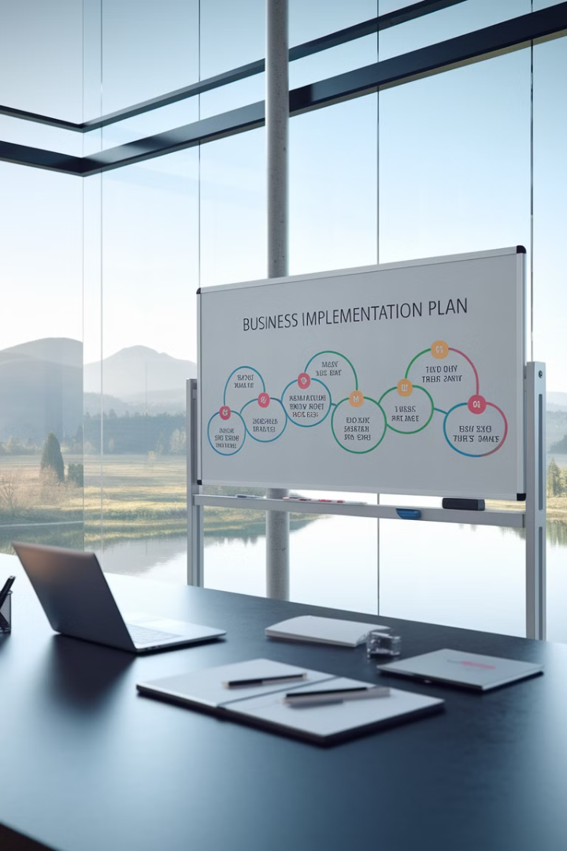
Getting Started: Your First 90 Days
Days 1-30: Assessment
Identify high-value opportunities. Document current pain points and process gaps.
Days 31-60: Build
Develop initial dashboards, workflows, and apps. Test with a small user group.
Days 61-90: Launch
Roll out solutions to wider audience. Gather feedback and measure impact.
Start your journey with this practical roadmap. Focus on delivering quick wins while building the foundation for long-term success.

Slide 10
The Connected Future of CRM
AI-Powered Insights
Leverage predictive analytics to anticipate customer needs and automate complex decisions.
Extensible Platform
Continuously add capabilities as your business grows. Connect to new systems without rebuilding.
Democratized Innovation
Enable business teams to solve their own problems with minimal IT intervention.
The future of CRM is connected, agile, and intelligent. By embracing the Power Platform, you're positioning your organization for ongoing innovation and competitive advantage.

Slide 11
Final Thoughts
Microsoft Dynamics CRM is just the beginning. By tapping into the broader Power Platform, organizations can empower their teams, automate more intelligently, and get deeper insight from their data.
For project managers, this means delivering more value with less complexity—while staying adaptable to changing business needs.
The future of CRM is connected, agile, and intelligent—and with the Power Platform, you're already halfway there.

