Slide 1
What if Everyone Who Wanted to Work Could?
Imagine a world where anyone who wanted a job could find one that paid the bills, offered purpose, and gave them stability and dignity. Scroll to learn how we can create a future of work that works for everyone.

Slide 2
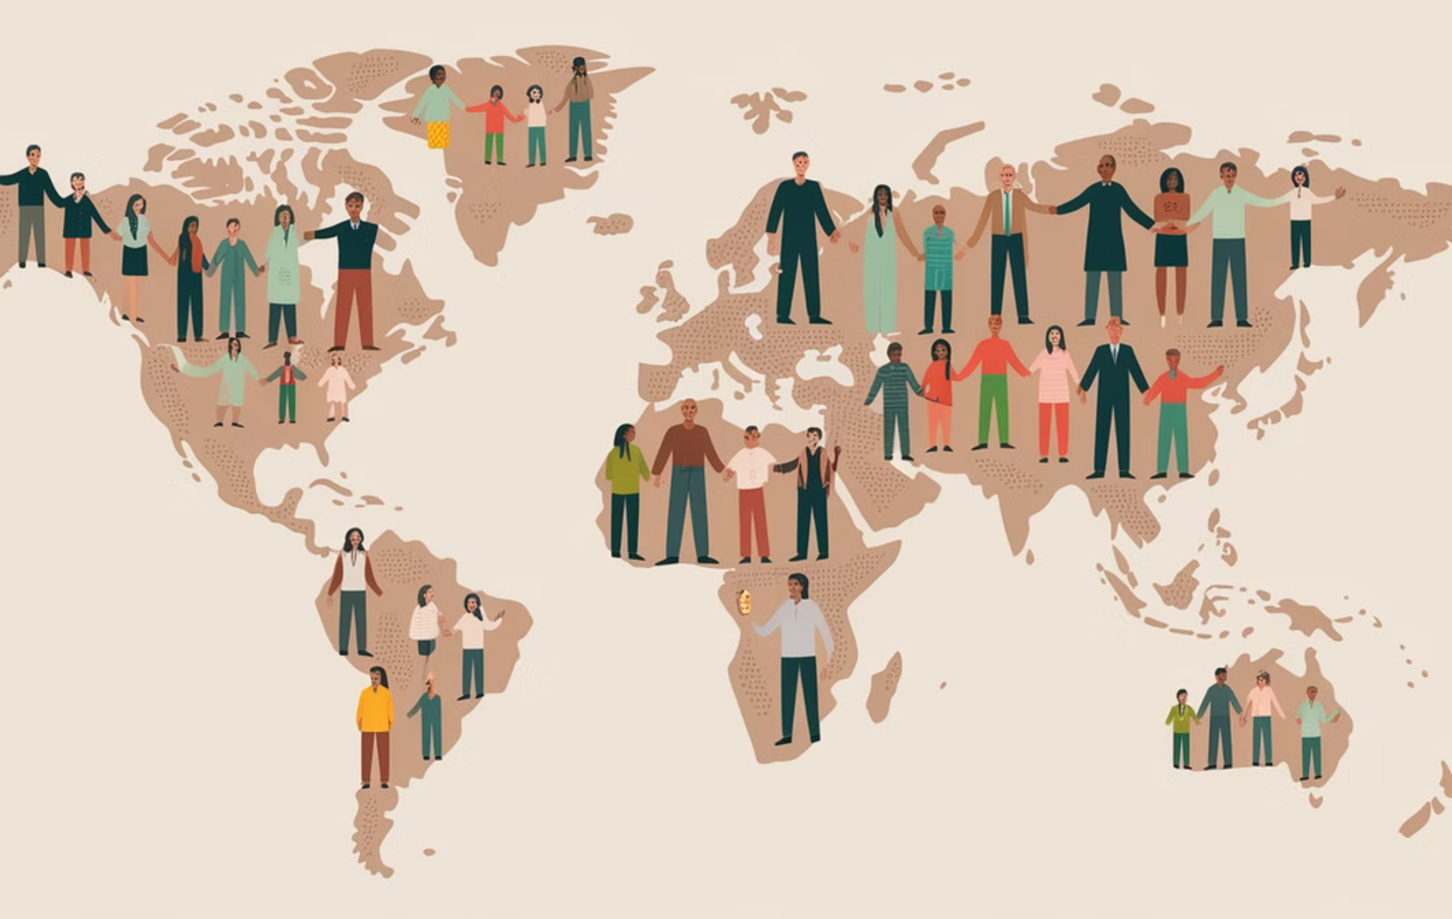
The World Needs Our Skills
There are millions of talented, dedicated individuals who are ready to contribute. They are not lacking skills. They are victims of broken hiring systems.

Slide 3
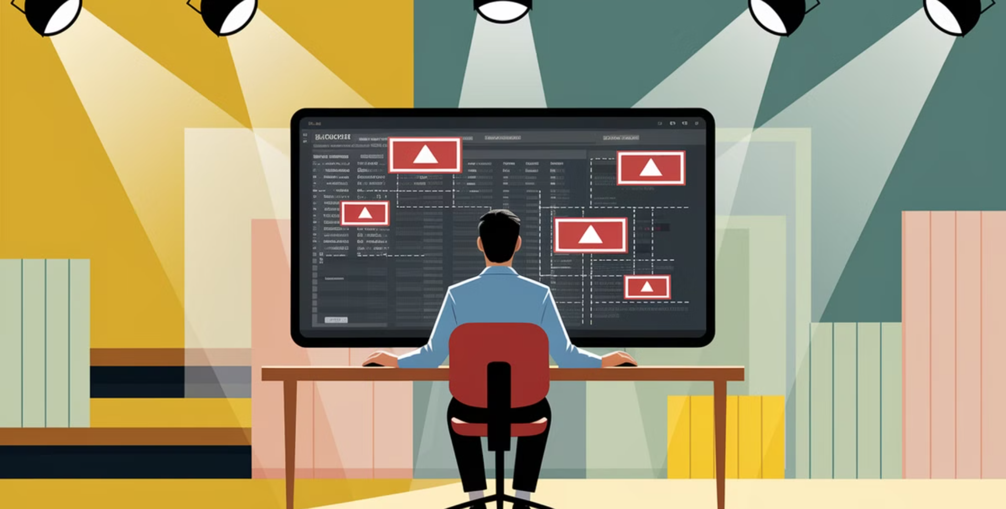
Why Can't We Find Workers?
Automated Filters
Companies rely on algorithms that prioritize resumes with specific keywords over genuine skills and experience.
Outdated Screening
Traditional resume and interview processes often fail to identify hidden talents and potential.

Slide 4
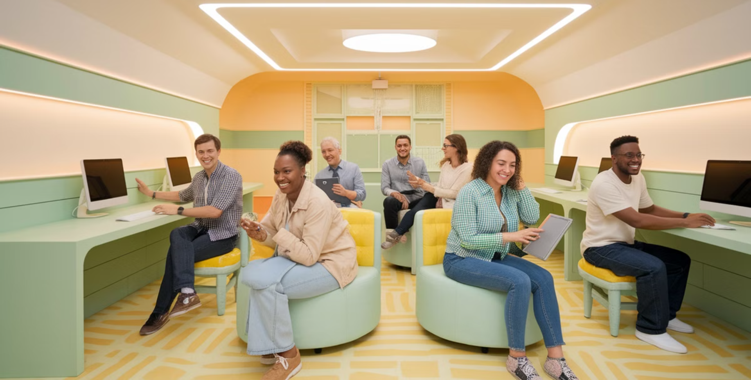
Investing in Workers, Not Just Profits
Upskilling & Reskilling
Companies need to invest in training programs that equip workers with the skills they need for the future.
Open Doors
Create more opportunities for those who may have been overlooked in the past.

Slide 5
Leadership for a Better World
Companies need to shift their mindset. They need to recognize that their employees are not just numbers, but the backbone of their success. This means:

Slide 6
Prioritize People Over Profits
Fair Compensation
Pay workers a living wage and offer benefits that support their well-being.
Meaningful Work
Create jobs that challenge employees and give them a sense of purpose and accomplishment.

Slide 7
The Future of Work is for Everyone
Work shouldn't be a privilege for the lucky few. We need to break down barriers and create a system where everyone has the opportunity to work and contribute.

Slide 8
What's Your Take? Let's Talk! 💬
Share your thoughts on the biggest barriers to meaningful employment. Let's work together to create a future of work where everyone who wants to work, can work.

