Slide 1
Free ATS Resume Checkers: Land Your Dream Job
In today's competitive job market, your resume needs to pass the Applicant Tracking System (ATS). Many companies use ATS software to scan and rank resumes. Optimizing your resume for ATS is crucial. This presentation will guide you to free tools that can help.
by Kimberly Wiethoff
kW

Slide 2
Why Check Your ATS Score?
Keyword Matching
Formatting Issues
Relevance
See how well your resume aligns with the job's keywords. Ensure you're using the right terms.
Identify layout problems that ATS systems can't read. Use a clean and standard format.
Check if your skills and experience match the job posting. Highlight relevant qualifications.

Slide 3
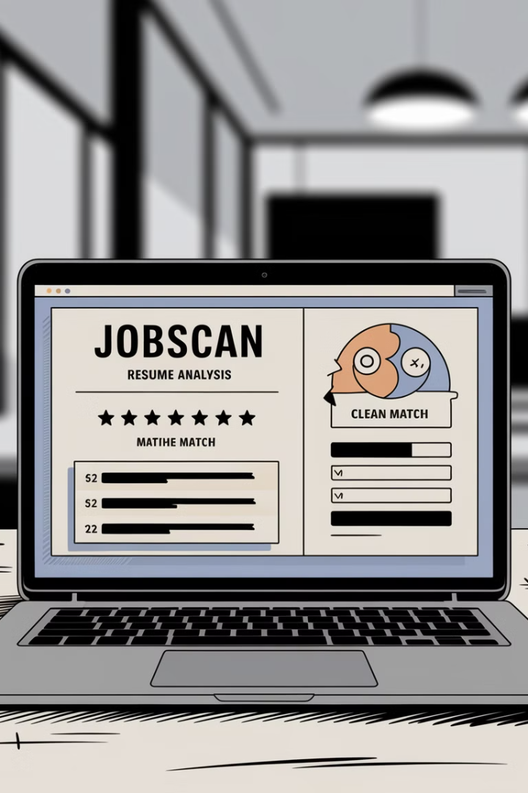
Jobscan: Match Percentage
1
Keyword Optimization
2
Skill Comparison
Analyzes your resume against job descriptions.
Compares your skills to the job's requirements.
3
Formatting Check
Checks for ATS-unfriendly formatting issues.

Slide 4
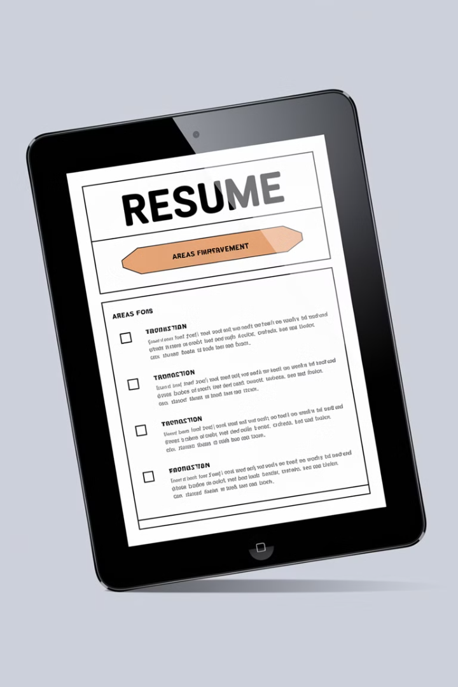
Resume Worded: ATS Score
ATS Score
Suggestions
Recommendations
Provides an ATS score for your resume.
Offers content improvement suggestions.
Gives keyword recommendations.

Slide 5
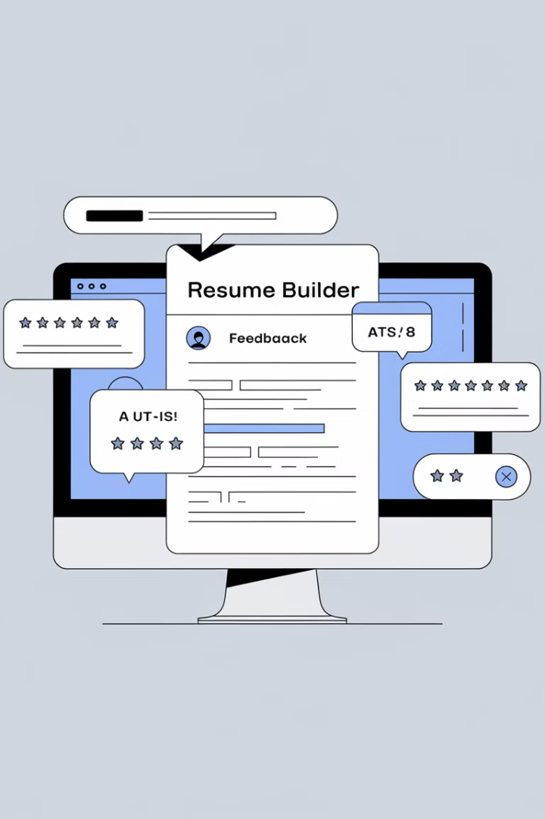
Zety: ATS-Friendly Builder
ATS Optimized
Customizable
Resume templates optimized for ATS.
Suggestions for improvement.
Real-Time Feedback
ATS compatibility feedback.

Slide 6
TopResume: Expert Review
1
Professional Assessment
Resume writers assess your resume.
2
Optimization Tips
Provides ATS optimization tips.
3
Detailed Feedback
Offers free detailed feedback.

Slide 7
SkillSyncer: Job Alignment
ATS Score
Provides an ATS score.
Keyword Matching
Offers analysis of keywords.
Formatting Checks
Checks for formatting issues.

Slide 8
ATS Scoring Tools
2
Resume Worded
Jobscan
1
Zety
3
5
SkillSyncer
4
TopResume
Optimize your resume for Applicant Tracking Systems with these free tools.

Slide 9
Keyword Optimization
1
Research
2
Identify
3
Implement
Research relevant keywords. Identify top keywords from job descriptions. Implement keywords naturally into your resume.

Slide 10
Formatting for ATS
1
Simple
2
Standard
3
Readable
Keep formatting simple. Use standard fonts. Ensure your resume is readable. Avoid complex layouts.

Slide 11
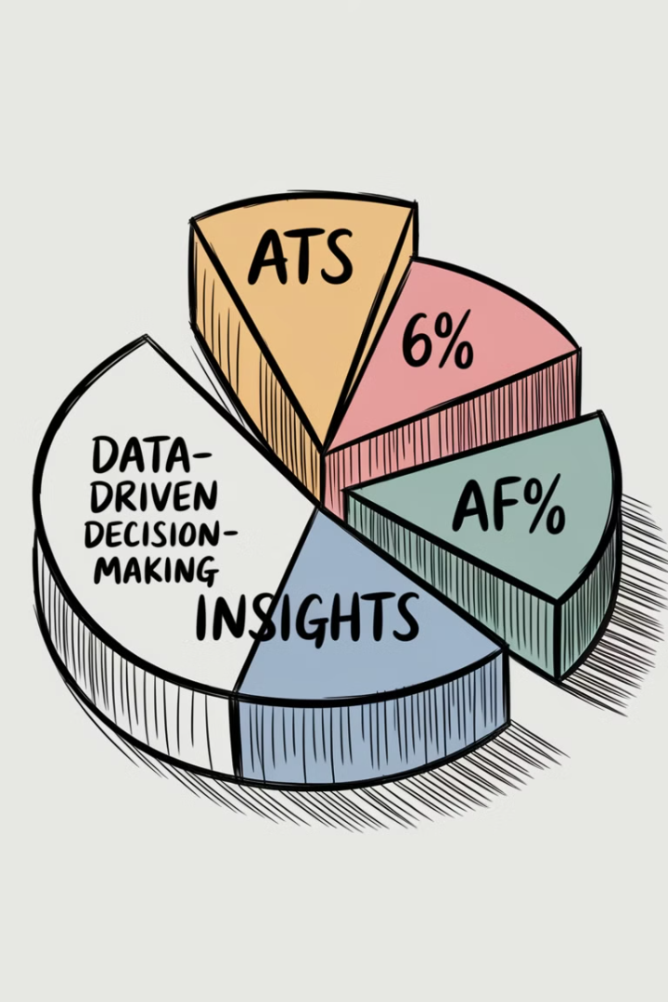
Maximize Your Chances
99%
75%
ATS Use
Resumes Filtered
Large companies use ATS.
Filtered before human review.
50%
Unqualified
Avoided by poor optimization.

Slide 12
Final Thoughts
Optimizing your resume for ATS systems is crucial. Use free ATS scoring tools to identify shortcomings. Boost your resume's performance and land in front of hiring managers. Increase your chances of getting that interview.

