Slide 1
Unlocking Hidden Job Opportunities
Discover the hidden job market. Learn to find unadvertised roles through networking and connections. Get ahead of the competition and unlock new opportunities before they hit the job boards.
kW
by Kimberly Wiethoff

Slide 2
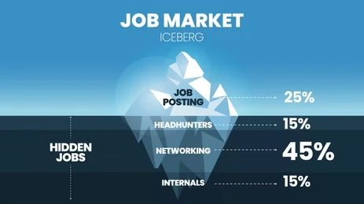
The Job Market Iceberg
Visible Market
Job postings, career fairs, and online portals are just the tip.
Hidden Market
Unadvertised roles found through networking and direct contact.

Slide 3
Networking: The Golden Key
1
Attend Events
2
Join Organizations
Connect at conferences and workshops.
Find opportunities through industry groups.
3
Use Social Media
Engage on LinkedIn and industry forums.

Slide 4
Effective Networking Strategies
Attend Industry Events
Join Professional Organizations
Utilize Social Media
Conferences, workshops, and seminars offer great connections.
Connect with industry professionals on LinkedIn.
Stay updated and open doors to potential jobs.

Slide 5
Mastering Informational Interviews
Research
Know the company and interviewer.
Build Rapport
Treat it as a conversation.
Express Interest
Subtly show your enthusiasm.

Slide 6
Making the Most of Informational Interviews
Preparation
Engagement
Thoroughly research the company and interviewer.
Build a genuine rapport through conversation.
Expression
Subtly express interest in opportunities.

Slide 7
Leverage Your Existing Connections
1
Reach Out
Contact former colleagues and mentors.
2
Stay in Touch
Keep your network updated.
3
Offer Value
Provide assistance and insights.

Slide 8
Strengthening Your Network
2
Stay in Touch
1
Reach Out
Offer Value
3

Slide 9
Monitor Company Websites
1
Check Often
2
Job Openings
3
Company Website
Make it a habit to regularly check company websites and social media. Look for new opportunities that align with your skills and interests. Some jobs are only posted there.

Slide 10
Stay Vigilant on Social Media
1
Follow
2
Company Page
3
Social Media
Companies post jobs on social media channels. Follow social media company accounts, such as LinkedIn, X and Facebook, and turn on notifications. Be notified when they post new roles!

Slide 11
Key Takeaways
80%
1
Hidden Jobs
Network
Most jobs are unadvertised.
Connections are crucial.
3
Be Proactive
Find opportunities early.

Slide 12
Next Steps
Start networking today. Build relationships and seek informational interviews. Monitor company websites and social media. Unlock your hidden job opportunities now!

