Slide 1
HIPAA Compliance and Medical Billing: What Your Practice Must Know
Medical billing extends far beyond submitting claims and collecting payments—it fundamentally involves protecting sensitive patient information. Every insurance claim, statement, and eligibility verification contains protected health information that must be safeguarded under HIPAA regulations.
Whether your practice handles billing internally or partners with third-party services, compliance failures can result in substantial financial penalties, legal repercussions, and devastating damage to patient trust. This presentation outlines critical knowledge for maintaining HIPAA compliance in your medical billing processes for 2025 and beyond.
kW
by Kimberly Wiethoff

Slide 2
Understanding Protected Health Information
Personal Identifiers
Clinical Information
Financial Records
Names, addresses, phone numbers, email addresses, and birthdates that can directly identify patients must be carefully protected throughout the billing process.
Diagnoses, treatment plans, medication lists, and clinical notes—all elements that appear on claims forms—constitute protected health information under HIPAA regulations.
Insurance details, billing records, payment histories, and account numbers require the same level of protection as clinical data when processing claims or discussing patient accounts.
HIPAA regulations are designed to safeguard all forms of protected health information throughout its lifecycle. Every staff member who interacts with patient billing information must understand their responsibility to maintain this protection both physically and electronically.

Slide 3
System Security Requirements
Encrypted Data Transmission
All electronic PHI must be encrypted during transmission between systems using current encryption standards that protect data from unauthorized access during claims submission.
Access Controls
Implement role-based access restrictions ensuring staff members can only access the minimum necessary information required to perform their specific job functions.
Secure Backups
Maintain encrypted, regularly tested data backups and documented disaster recovery protocols to prevent data loss while maintaining compliance during system failures.
Business Associate Agreements
Establish formal BAAs with all third-party vendors who access, transmit, or store PHI, including clearinghouses, billing services, and software providers.
HIPAA requires not only implementing these security measures but also documenting your compliance efforts through regular risk assessments and system audits.

Slide 4
Staff Training Imperatives
Recognize Security Threats
Physical Record Handling
Train staff to identify phishing attempts, social engineering tactics, and other cybersecurity risks that specifically target healthcare billing information.
Establish protocols for secure handling of paper statements, explanation of benefits documents, and other physical billing records that contain PHI.
Breach Reporting Procedures
Communication Guidelines
Ensure all team members understand the specific steps for reporting potential data breaches or security incidents involving billing information.
Develop clear rules for discussing billing matters with patients, insurance representatives, and colleagues to prevent accidental PHI disclosures.
Document all training sessions with attendance records and regularly update materials to address emerging threats and regulatory changes. Conduct refresher training at least annually.

Slide 5
Common HIPAA Violations in Medical Billing
Misdirected Communications
Public Discussions
Improper Disposal
Unsecured Workstations
Talking about patient billing details in waiting rooms, hallways or other public spaces where conversations can be overheard violates privacy requirements.
Failing to shred billing documents or securely dispose of electronic media containing PHI before discarding creates significant compliance risks.
Sending statements or bills to incorrect addresses or emailing unencrypted PHI can constitute serious violations, even when accidental.
Leaving billing systems logged in when unattended or positioning screens where unauthorized individuals can view PHI violates security requirements.
Even unintentional HIPAA violations can result in substantial penalties. The Office for Civil Rights has increased enforcement actions against smaller practices in recent years, with fines starting at $100 per violation and potentially reaching millions of dollars for systemic issues.

Slide 6
Monitoring Your Practice's Compliance
Regular Risk Assessments
Conduct comprehensive evaluations of potential vulnerabilities in your billing systems and processes at least annually, documenting findings and remediation plans.
Random Process Audits
Perform unannounced audits of billing procedures to ensure staff consistently follow HIPAA-compliant protocols when handling patient information.
Documentation Reviews
Regularly examine privacy notices, authorization forms, and billing policies to ensure they accurately reflect current practices and regulatory requirements.
Vendor Assessment
Periodically evaluate third-party billing services and software providers to verify their continued compliance with HIPAA standards and BAA terms.
Maintaining detailed records of all monitoring activities provides crucial evidence of your compliance efforts in case of an audit. Assign responsibility for oversight to specific individuals to ensure accountability.

Slide 7
Vetting Third-Party Billing Services
Compliance Certification
Verify vendors maintain current industry certifications
Staff Credentials
Confirm training and background check procedures
Technical Safeguards
Evaluate encryption, access controls, and data handling
Contractual Protections
4
Secure comprehensive Business Associate Agreement
When outsourcing medical billing functions, your practice remains ultimately responsible for HIPAA compliance. Thoroughly investigate potential vendors before sharing any patient data, and maintain ongoing oversight throughout the relationship.
Request documentation of the vendor's annual security risk assessment, incident response plan, and staff training program. Ensure the Business Associate Agreement explicitly outlines breach notification procedures and liability allocation.

Slide 8
Electronic Communications and HIPAA
Secure Email Practices
Text Message Limitations
Implement encryption for all emails containing PHI, including billing inquiries and payment confirmations
Avoid sending billing information via standard SMS; use secure patient portals instead
Patient Portal Security
Phone Call Protocols
Ensure online payment systems and account access meet encryption and authentication requirements
Verify caller identity before discussing billing details and avoid leaving detailed messages
With the increasing digitization of healthcare billing, secure communication practices have become essential for HIPAA compliance. Implement clear protocols for staff regarding acceptable communication channels for different types of billing information.
Remember that convenience should never supersede security when communicating about patient financial information. Document patient communication preferences and obtain appropriate authorizations before using email or text for billing matters.

Slide 9
Breach Response Planning
Remediation Implementation
Notification Procedures
Thorough Investigation
Immediate Containment
Address the underlying vulnerability that allowed the breach to occur through system updates, policy changes, or additional staff training focused on billing security practices.
Follow HIPAA's specific requirements for timely notification to affected patients, HHS, and potentially the media for larger breaches. Provide required information about the breach and steps patients should take to protect themselves.
Document exactly what billing information was compromised, how the breach occurred, and which patients may be affected. Determine whether the incident meets HIPAA's definition of a reportable breach requiring notification.
Rapidly identify and limit the extent of any potential breach involving billing information. Isolate affected systems or documents to prevent further unauthorized access while preserving evidence for investigation.
Having a comprehensive breach response plan specific to billing information is essential for minimizing damage and ensuring regulatory compliance. Conduct regular drills to test your response procedures.

Slide 10
Documentation Requirements
Policies and Procedures
Detailed documentation of all billing-related security protocols
Training Records
Evidence of staff education on HIPAA billing requirements
Risk Assessments
Regular evaluations of billing process vulnerabilities
Incident Reports
Documentation of any potential breaches or security events
HIPAA requires maintaining these records for at least six years from creation or last effective date. Documentation isn't just about regulatory compliance—it's your best defense in case of an audit or investigation.
Establish a secure, accessible documentation system with regular review cycles to ensure all records remain current. Assign clear responsibility for maintaining these critical compliance documents to prevent gaps in your documentation trail.

Slide 11
Penalties for HIPAA Violations
$100
$50,000
Minimum Per Violation
Maximum Per Violation
Starting point for each individual violation when the practice was unaware and exercised reasonable diligence
Cap for each violation resulting from willful neglect without timely correction
$1.5M
10+
Annual Maximum
Years of Monitoring
Yearly cap per identical provision violated, applicable to most medical practices
Length of mandated compliance monitoring frequently imposed after significant violations
Beyond financial penalties, HIPAA violations related to billing practices can lead to criminal charges for intentional misuse of patient information. Staff members may face individual liability for knowingly violating HIPAA rules.
The reputational damage from a publicized breach often exceeds the immediate financial penalties, potentially affecting patient trust and practice growth for years afterward.

Slide 12
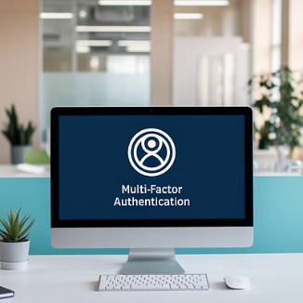
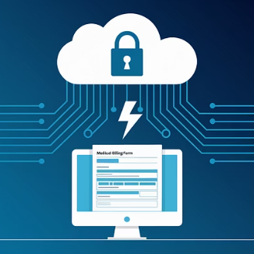
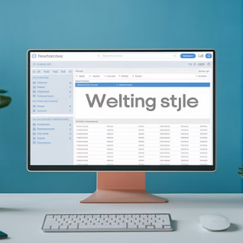
Technological Safeguards
Implementing appropriate technological safeguards is essential for protecting billing information in today's increasingly digital healthcare environment. Key measures include multi-factor authentication, automatic logoff features, and encrypted data transmission.
Regular system updates and security patches must be applied promptly to protect against newly discovered vulnerabilities. Maintain comprehensive audit logs of all access to billing systems to detect and investigate any unusual patterns that might indicate a security issue.

Slide 13
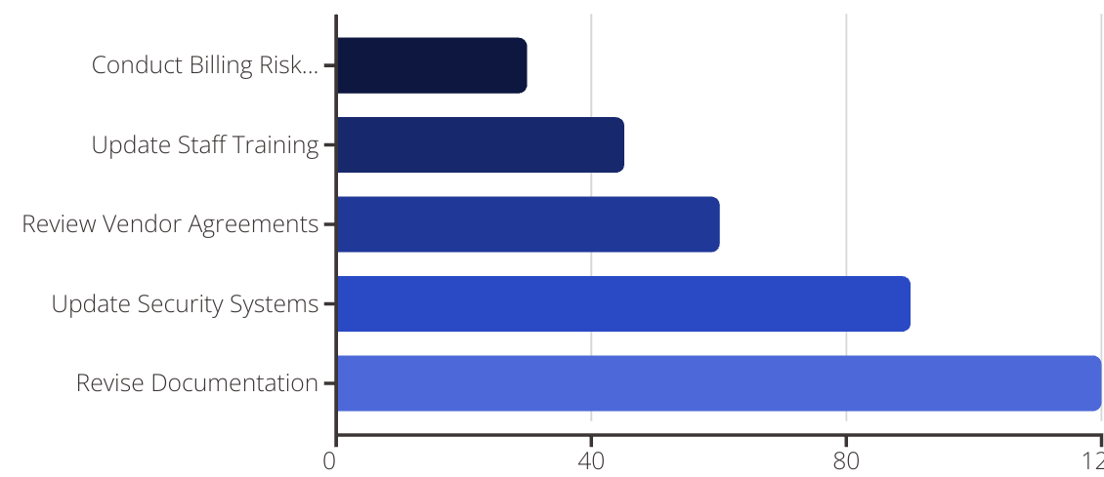
Next Steps for Your Practice
Begin your compliance improvement journey by conducting a comprehensive risk assessment focused specifically on your billing processes. Identify gaps between current practices and HIPAA requirements, then develop a prioritized remediation plan with clear timelines and accountability.
Designate a HIPAA compliance officer responsible for overseeing these initiatives and maintaining ongoing vigilance. Remember that HIPAA compliance in medical billing isn't a one-time project but a continuous commitment to protecting patient information while efficiently managing your practice's revenue cycle.

Slide 14
Final Thoughts
HIPAA compliance isn't just a regulatory box to check—it’s foundational to running a trustworthy and financially healthy practice. In medical billing, compliance should be built into every process, tool, and communication. Protect your patients, protect your reputation, and protect your revenue by making HIPAA a priority.

