Slide 1
Mastering Stakeholder Management in Cross-Functional IT Projects
In the dynamic realm of IT projects, success hinges on navigating complex stakeholder landscapes. This presentation explores key tips and techniques for effective stakeholder management, empowering you to achieve project goals and build lasting relationships.
kW
by Kimberly Wiethoff

Slide 2
Identifying and Prioritizing Stakeholders
Mapping the Landscape
Prioritization
Begin by identifying all potential stakeholders – those directly involved and those impacted by the project's outcomes. This includes end-users, executives, and cross-functional teams.
Prioritize stakeholders based on influence, interest, and impact on the project. This helps focus your efforts on those who hold the greatest sway.

Slide 3
Understanding Stakeholder Needs and Expectations
Active Listening
Tailored Solutions
Engage with stakeholders early to understand their needs, expectations, and concerns. Utilize interviews, surveys, and workshops to gather insights.
This information allows you to tailor project strategies and communication plans to address specific stakeholder requirements, ensuring alignment and satisfaction.

Slide 4
Building Trust and Credibility
Transparency
Reliability
Keep stakeholders informed about project progress, challenges, and successes. Honesty builds trust and fosters positive relationships.
Delivering on commitments consistently enhances your credibility and reinforces stakeholder confidence in the project's success.

Slide 5
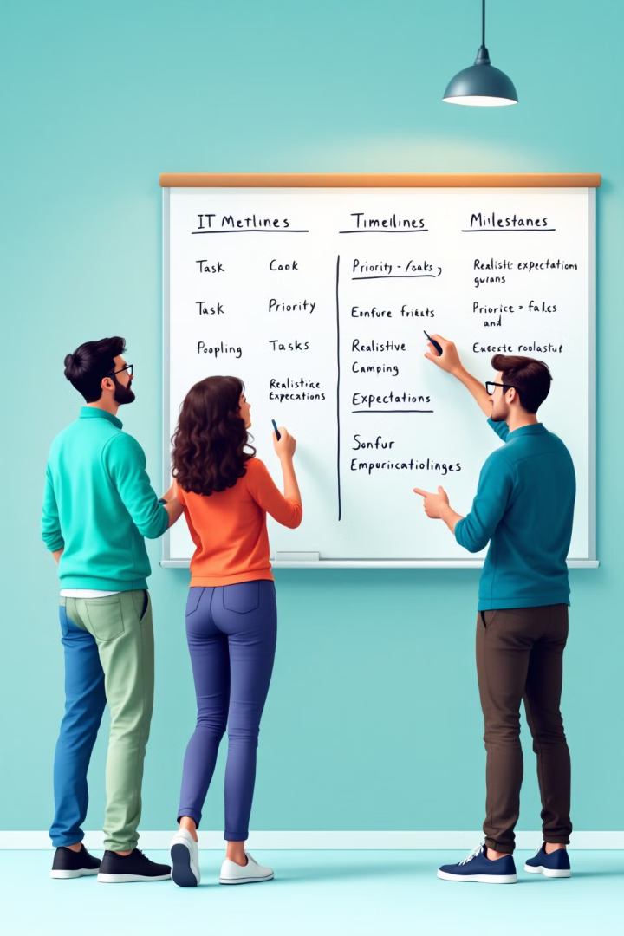
Managing Expectations Realistically
1
Avoid overpromising to stakeholders, as it can lead to disappointment. Set realistic expectations regarding scope, timelines, and deliverables.
2
Instead, under promise and overdeliver by exceeding expectations whenever possible, reinforcing stakeholder confidence and trust.

Slide 6
Customizing Communication Styles
Different stakeholders have different communication preferences. Some may prefer detailed reports, while others may prefer quick summaries.
Utilize a combination of emails, meetings, project management tools, and collaboration platforms to ensure seamless information flow.
Adapt your communication style to each stakeholder group, ensuring they feel heard and valued.

Slide 7
Anticipating and Addressing Resistance
Identify Sources
1
Be proactive in identifying potential sources of resistance among stakeholders.
Mitigate Concerns
2
Address concerns empathetically, provide rationale for decisions, and involve stakeholders in the decision-making process.

Slide 8
Celebrating Achievements and Milestones
Recognize Success
1
Recognize and celebrate project achievements and milestones publicly, boosting team morale and reinforcing stakeholder confidence.
Build Momentum
2
This positive reinforcement keeps the project moving forward and helps maintain a strong sense of progress.

Slide 9
Continuously Engage and Adapt
1
2
Soliciting Feedback
Adaptable Strategies
Continuously solicit feedback and reassess stakeholder needs throughout the project lifecycle.
Adapt your strategies accordingly to address evolving stakeholder dynamics and maintain project alignment.

Slide 10
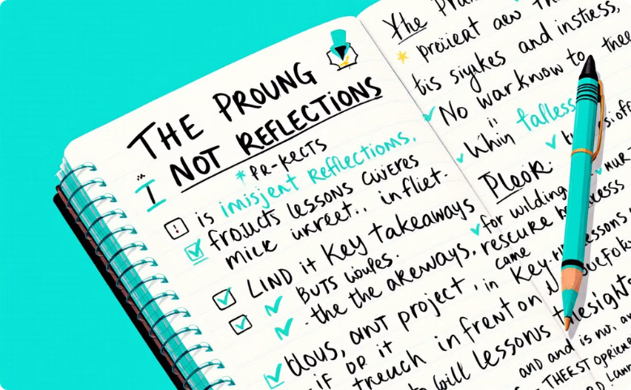
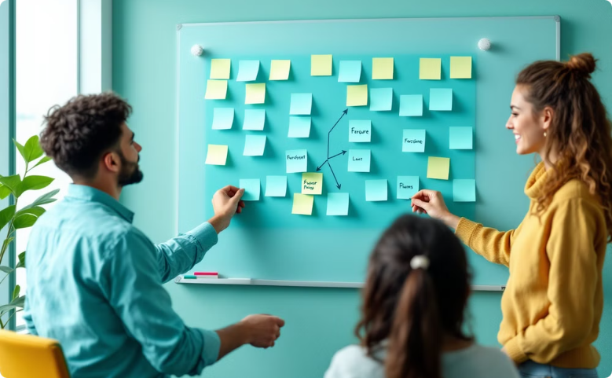
Documenting and Learning from Experiences
Capturing Insights
Refining Approaches
Document lessons learned throughout the project lifecycle, including successes, failures, and key insights gained from stakeholder interactions.
Use this knowledge to refine your stakeholder management approach in future projects, fostering continuous improvement.

Slide 11
Key Takeaways: Stakeholder Management Success
Proactive Communication
Trust-Building
Strategic Adaptation
Set realistic expectations and consistently deliver on promises to maintain credibility
Anticipate resistance, address concerns empathetically, and remain flexible
Adapt communication styles and continuously engage stakeholders throughout the project lifecycle
By implementing these principles, project managers can transform stakeholder interactions from transactional to truly collaborative partnerships.

Slide 12
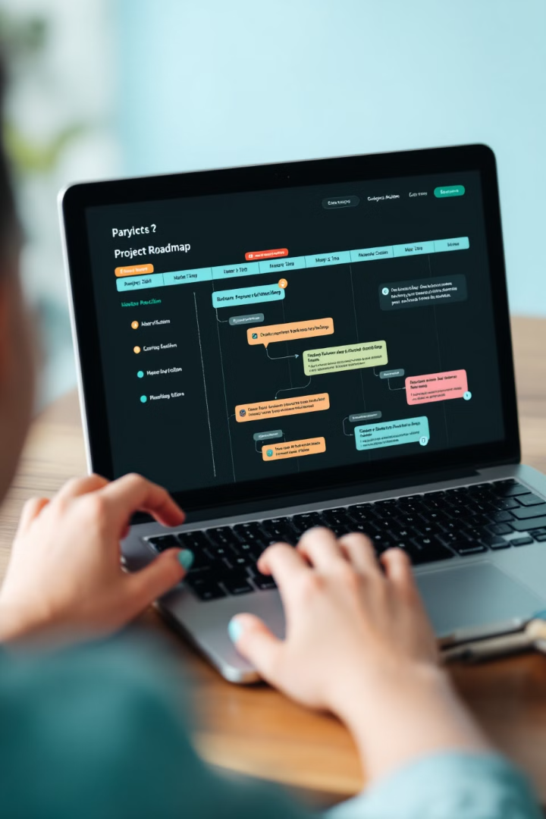
Next Steps
Implement the techniques outlined in this presentation to elevate your stakeholder management capabilities. Embrace continuous learning and refinement to foster positive relationships, achieve project success, and drive impactful outcomes.

