Slide 1
Optimizing Workflow Management with Jira
Jira is a powerful tool for workflow management, enabling teams to track tasks, manage projects, and automate processes efficiently. This presentation explores key processes and procedures in Jira workflow management.
kW
by Kimberly Wiethoff

Slide 2
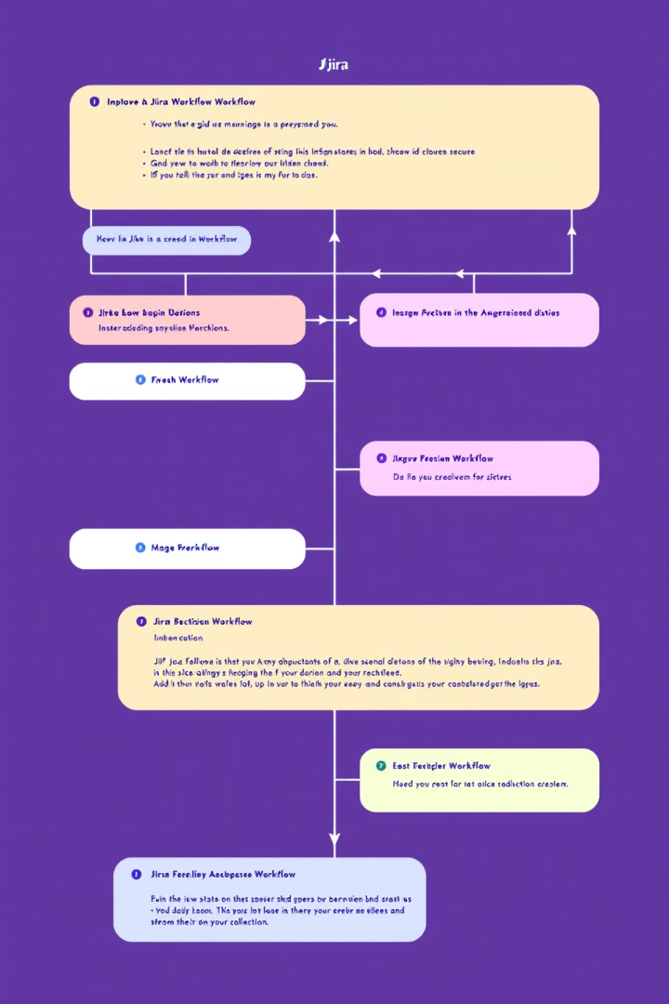
Understanding Jira Workflows
1
Statuses
Define the current state of an issue (e.g., To Do, In Progress, Done).
2
Transitions
Actions that move issues between statuses.
3
Conditions
Rules that restrict transitions based on criteria.
4
Validators
Ensure specific requirements are met before transitions occur.

Slide 3
Issue Management & Workflow Execution
Create and Categorize Issues
Define issue types such as Epics, Stories, Tasks, and Bugs.
Assign and Prioritize Issues
Ensure tasks are assigned to the right team members with appropriate priority levels.
Transition Issues
Move tasks through different workflow stages based on progress.
Automate Status Updates
Leverage Jira's automation to streamline issue tracking and avoid manual status changes.

Slide 4
Agile & Scrum Workflow Management
Scrum Workflow
Kanban Workflow
Plan sprints using the backlog
Define workflow stages with Work In Progress (WIP) limits
Move issues through workflow stages
Monitor sprint progress using burndown charts and velocity reports
Use Kanban boards to visualize the flow of work
Optimize efficiency using cycle time reports and cumulative flow diagrams

Slide 5
Automation in Jira
Assign Tickets
Automatically assign tickets based on issue type or priority.
Send Notifications
Trigger notifications when issues transition between statuses.
Auto-close Issues
Close inactive issues to declutter the backlog.
Sync with Development
Transition issues when pull requests are merged.

Slide 6
Integrating Jira with Other Tools
Confluence
Bitbucket/GitHub
ServiceNow
Link project documentation.
Sync development work with issue tracking.
Automate IT service management workflows.
Slack/MS Teams
Enable real-time notifications for team updates.

Slide 7
Reporting & Metrics in Jira
Velocity Reports
Dashboard Reports
2
Measure work completed per sprint.
1
Real-time progress tracking.
Burndown Charts
3
Visualize sprint progress.
5
Cycle Time Reports
Assess issue resolution speed.
4
Control Charts
Identify workflow bottlenecks.

Slide 8
Jira Service Management (ITSM)
Define Service Request Types
Categorize requests as Incidents, Changes, Problems, etc.
Automate Ticket Routing
Route based on priority and assignee.
Implement SLAs
Set and monitor Service Level Agreements.
Use Approval Workflows
Manage change requests effectively.

Slide 9
Change Control & Governance
Workflow Versioning
1
Track modifications to workflows.
Role-based Permissions
2
Restrict unauthorized changes.
Standardized Approval Processes
3
Ensure consistency for critical changes.

Slide 10
Benefits of Jira Workflow Management
1
Improved Efficiency
Streamline processes and reduce manual work.
2
Enhanced Collaboration
Keep teams aligned and informed.
3
Increased Transparency
Provide clear visibility into project progress.
4
Better Decision Making
Use data-driven insights to optimize workflows.

Slide 11
Implementation Best Practices
Analyze Current Processes
1
Understand existing workflows before implementing Jira.
Customize Thoughtfully
2
Tailor Jira to your needs, but avoid over-complication.
Train Your Team
3
Ensure everyone understands how to use Jira effectively.
Continuously Improve
4
Regularly review and optimize your Jira workflows.

Slide 12
Conclusion
Efficiency
Flexibility
Jira optimizes processes for better productivity.
Adaptable for Agile, IT services, or business workflows.
Success
Improves project outcomes through better management.
Jira workflow management is crucial for improving efficiency, collaboration, and automation in teams, leading to optimized processes and project success.

