Slide 1
Successfully Navigating Migration Projects: A Guide to Seamless Transitions
Migration projects are critical milestones for organizations modernizing their technology landscapes. Whether moving to the cloud, adopting a new ERP system, or transitioning to a different data platform, these projects require meticulous planning, clear communication, and precise execution. This guide provides actionable insights to ensure a smooth and successful migration.
kW
by Kimberly Wiethoff

Slide 2
1. Define the Scope and Objectives
Understanding the Scope
Phased Approach
A successful migration begins with a crystal-clear understanding of its scope and objectives. Identify what will be migrated, the timeline, and the desired outcomes. Whether it’s data, applications, or infrastructure, documenting the scope ensures alignment among stakeholders.
Break the migration into phases to reduce complexity and focus on incremental wins. This helps maintain momentum and allows for adjustments along the way.

Slide 3
2. Assess the Current Environment
Thorough Analysis
Early Identification of Challenges
Before starting the migration, thoroughly analyze the existing environment. Understand dependencies, identify risks, and evaluate the readiness of systems and teams.
Use tools like dependency mapping and readiness assessments to identify gaps early. Addressing these proactively minimizes surprises during the migration process.

Slide 4
3. Choose the Right Tools and Partners
Cloud Migration
Data Migration
Expert Collaboration
Cloud migrations may require tools like AWS Migration Hub or Azure Migrate, which streamline the process and offer comprehensive support.
Data migrations might benefit from ETL (Extract, Transform, Load) solutions, which efficiently move large datasets while maintaining data integrity.
Collaborate with experienced partners who have expertise in the specific type of migration you are undertaking. They can provide guidance, best practices, and valuable support.

Slide 5
4. Develop a Comprehensive Migration Plan
Detailed Planning
Risk Mitigation
A detailed migration plan is essential for minimizing disruptions. This plan should include timelines, roles, responsibilities, fallback mechanisms, and communication protocols.
Incorporate a rollback plan to mitigate risks in case of unforeseen issues. This ensures a safe and controlled process, preventing potential downtime.

Slide 6
5. Test, Test, Test
1
Pre-Migration Testing
2
Post-Migration Testing
3
Controlled Simulation
Conduct pre-migration tests to validate compatibility. This step ensures that the migrated system integrates smoothly with existing infrastructure.
Conduct post-migration tests to ensure everything works as intended. These tests confirm that the migration was successful and the new system is fully operational.
Simulate the migration process in a controlled environment to uncover potential issues. This proactive approach helps identify and resolve problems before they impact the live environment.

Slide 7
6. Communicate Effectively with Stakeholders
Regular Updates
Centralized Hub
Provide regular updates on progress, addressing concerns promptly and setting realistic expectations for outcomes and timelines.
Create a centralized communication hub to ensure all stakeholders have access to the latest updates and documentation. This fosters transparency and keeps everyone informed.

Slide 8
7. Focus on Change Management
1
Explain the reasons for the migration to employees, highlighting the benefits and value they can expect from the transition.
2
Provide comprehensive training on the new system, tools, and workflows, ensuring employees are comfortable using the updated environment.
3
Offer ongoing support resources and guidance to help users adapt smoothly to the changes. This could include FAQs, online forums, or dedicated help desks.

Slide 9
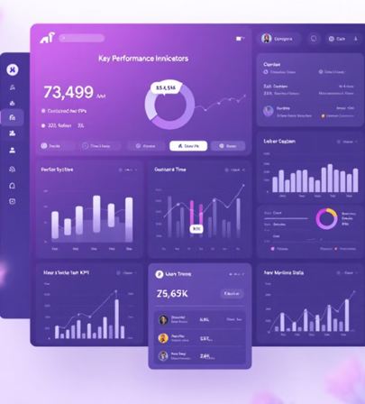
8. Monitor and Optimize Post-Migration
Performance Monitoring
Monitor the new environment for performance, security, and usability issues. This proactive approach ensures that the system functions as expected and provides a positive user experience.
Analytics and Optimization
Use analytics to measure success and identify areas for optimization. This data-driven approach helps continually improve processes and maximize the benefits of the migration.

Slide 10
Final Thoughts
Migration projects are complex but incredibly rewarding when executed well. By defining clear objectives, leveraging the right tools, testing thoroughly, and prioritizing communication, organizations can minimize risks and achieve a seamless transition. Remember, every migration is an opportunity to modernize, optimize, and position your organization for future success.

