Slide 1
Mastering LinkedIn Networking
LinkedIn is a powerful tool. Use it for building relationships, expanding your network, and advancing your career. With over 700M users worldwide, LinkedIn offers many opportunities. Connect with like-minded professionals, potential employers, mentors, and industry influencers.
kW
by Kimberly Wiethoff

Slide 2
Optimize Your Profile
1
Profile Picture
Use a high-quality profile picture.
2
Compelling Headline
Highlight your skills and expertise.
3
Concise Summary
Showcase your achievements and aspirations.
4
Relevant Keywords
Improve visibility in search results.
Ensure your profile is complete and professional. Make it engaging. Include relevant keywords to improve visibility.

Slide 3
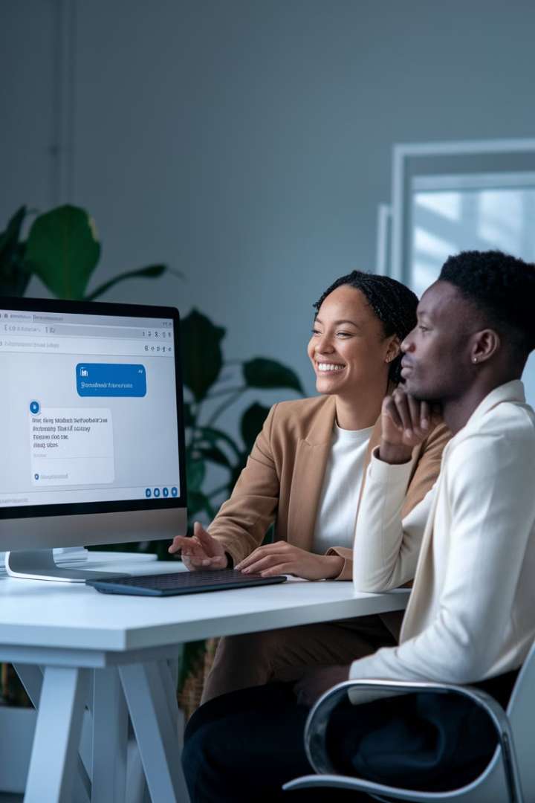
Personalize Connection Requests
Avoid Generic Messages
Reference Mutual Interests
Demonstrate Sincerity
Be specific about your interest in connecting.
Mention shared connections.
Show your intention to build a relationship.
Personalize your connection requests. Reference mutual interests. This demonstrates your sincerity.

Slide 4
Engage with Content
Like Posts
Comment on Posts
Share Posts
Show your support for relevant content.
Provide thoughtful insights and ask questions.
Contribute value to the LinkedIn community.
Engage with content to establish your presence. Provide thoughtful insights. Increase your visibility.

Slide 5
Join and Participate in Groups
Relevant Groups
Active Participation
Find groups related to your industry.
Engage in discussions.
Share Insights
Establish yourself as knowledgeable.
LinkedIn Groups are a resource for connecting with professionals. Actively participate. Expand your network.

Slide 6
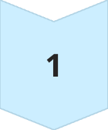
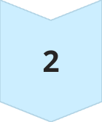
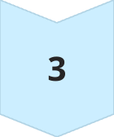
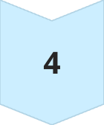
Offer Help and Support
Share Articles
Provide Recommendations
Offer Advice
Make Introductions
Networking is about what you can give. Offer help and resources to your connections. Build a reputation as a helpful networker.

Slide 7
Request Informational Interviews
1
Reach Out
Contact professionals in your field.
2
Prepare Questions
Show your interest and knowledge.
3
Listen Actively
Absorb their experiences.
4
Express Gratitude
Acknowledge their time.
Informational interviews are effective. Learn from industry experts. Gain insights into career paths.

Slide 8
Follow Up and Nurture Relationships
2
Congratulate Milestones
Personalized Messages
1
3
Share Resources
Follow up to stay top of mind. Nurture the relationship over time. Building relationships requires effort.

Slide 9
Putting It All Together
Follow Up
Engage with Content
Personalize Requests
Optimize Profile
Networking is a way to build connections. Open doors to opportunities. Effective networking is the key to progress.

Slide 10
Key Takeaways
LinkedIn is a way to build connections and expand your network. By optimizing your profile and networking, you can unlock LinkedIn's potential. It can help with opportunities and collaborations.

