Slide 1
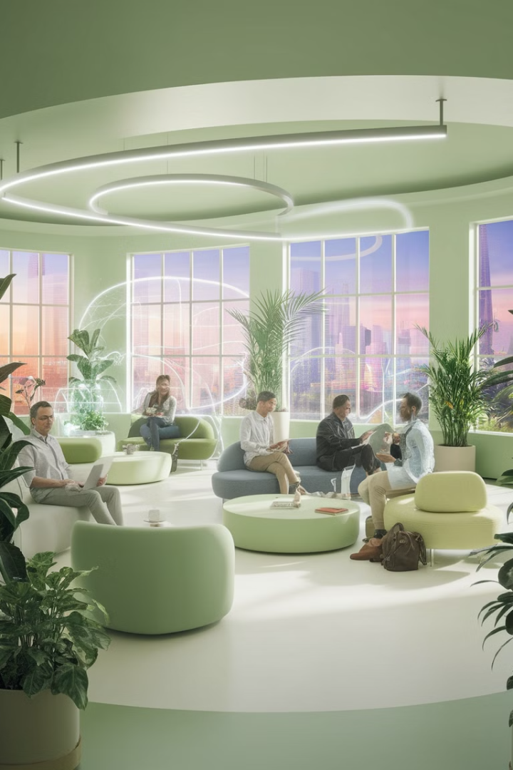
Embracing the Remote-First Work Revolution
The shift towards remote-first work is reshaping the modern business landscape. Companies that embrace this model are gaining a competitive edge. Remote-first prioritizes flexibility, innovation, and cost savings.
kW
by Kimberly Wiethoff

Slide 2
Access a World of Talent
Global Reach
Diverse Perspectives
Scalable Teams
Eliminate geographic barriers and hire the best talent. Access skilled professionals beyond your local area.
Create diversity and foster innovation with varied experiences. A wider talent pool ensures a strategic advantage.
Grow teams across multiple time zones for easier scaling. Remote-first promotes a dynamic and expansive workforce.

Slide 3
Boosting Productivity and Performance
1
Increased Output
2
Focused Work
Remote workers show a 13% boost in productivity. Minimize commute time and workplace distractions.
Enable deep work by allowing employees to customize their environment. Prioritize outcomes over hours for higher engagement.
3
Efficient Engagement
Remote-first companies prioritize outcomes, leading to higher engagement. Efficiency is boosted through autonomy and trust.

Slide 4
Unlock Cost Savings for All
Reduced Overhead
No Relocation Fees
Lower expenses on office space, utilities, and maintenance. Virtual meetings cut business travel costs.
Eliminate relocation expenses when hiring top talent. Expand your reach without added financial strain.
Employee Savings
Employees save on commuting, attire, and dining. Financial well-being improves overall job satisfaction.

Slide 5
Work-Life Harmony and Retention
Greater flexibility to balance work and personal life. Adjust your work environment to suit your lifestyle.
More time spent with family improves job satisfaction. Happy employees mean increased loyalty.
Reduce burnout, leading to higher retention rates. Lower turnover fosters a loyal, engaged workforce.

Slide 6
Go Green with Remote-First
1
Lower Carbon Footprint
Reduce commuting and decrease emissions. Remote work lowers environmental impact.
2
Less Waste
Minimize office waste, promoting sustainable practices. Digital operations contribute to environmental health.
3
Reduced Congestion
Decentralized workforces ease urban crowding. Remote-first supports corporate social responsibility (CSR).

Slide 7
Stay Competitive in a Changing World
Attract Young Talent
Retain Experience
Future-Proof Your Business
Younger professionals value flexibility. Offer autonomy to attract top candidates.
Keep experienced employees with location independence. Remote-first is a powerful retention tool.
Adapt to digital transformation trends. Remote-first is an advantage for recruiting and empowering talent.

Slide 8
Embrace the Future: Remote-First Success
2
Productivity
1
Innovation
Inclusivity
3
Thrive by adapting to the changing nature of work. A remote-first environment fosters success. Create innovation, productivity, and inclusivity.

Slide 9
A Strategic Approach
1
Growth
2
Efficiency
3
Flexibility
Remote-first environments provide flexibility. Embrace the benefits of efficiency and talent. See the possibilities of long-term growth.

Slide 10
Steps to Remote-First
1
Assess
2
Implement
3
Optimize
Transition to a remote-first model effectively. Follow the steps to implementation. Optimize remote-first.

Slide 11
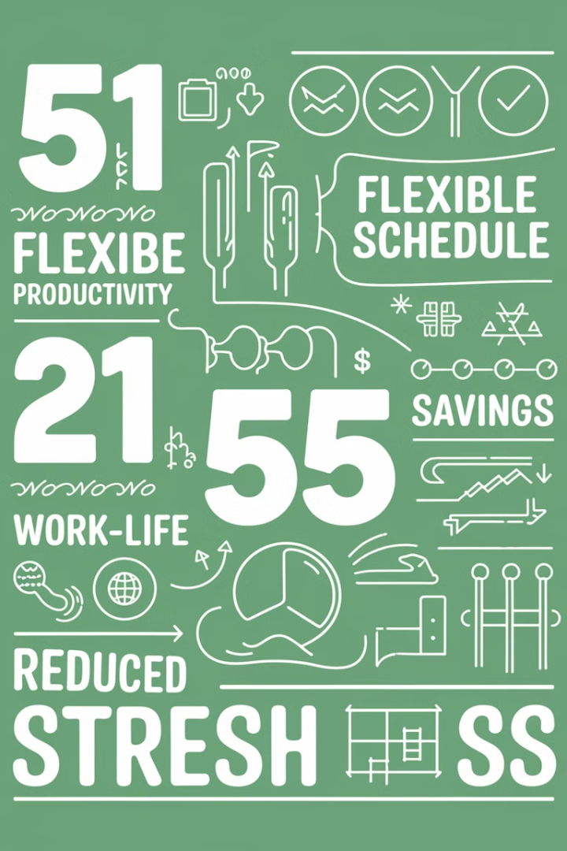
Remote-First: By the Numbers
13%
50%
Productivity
Cost Savings
25%
Retention
The numbers show significant benefits. Experience 13% higher productivity, 50% cost savings, and 25% higher retention by going remote-first.

Slide 12
Success Stories: Remote-First in Action
Tech Innovator
Marketing Leader
Service Excellence
Increased productivity by 30%.
Reduced overhead costs by 40%.
Improved employee retention by 20%.

