Slide 1
Holiday Layoffs: The Human Cost
Imagine losing your job right before Christmas, a time meant for joy and family. It's a harsh reality for many.

Slide 2
Putting People First: A Myth?
Timing Speaks Volumes
Why are layoffs so often announced during holidays? It's insensitive and sends a message that company profits matter more than employees.
Beyond "Business Needs"
Companies talk about business needs, but they forget the human impact. These decisions affect people's lives, not just spreadsheets.

Slide 3
More Than Just a Job
These layoffs aren't just about losing a paycheck. It's about losing a sense of security and stability, and facing the holidays with uncertainty.

Slide 4
The True Meaning of Leadership
Leadership isn't just about making tough decisions. It's about showing compassion and understanding during difficult times.

Slide 5
A Message of Hope
To those affected by holiday layoffs, remember that your value isn't defined by a company's decision. There are better opportunities ahead, and your skills and resilience will shine.

Slide 6
Companies: Time for a Shift
Before making layoffs, companies need to ask themselves if this is the most humane way to handle the situation. How you treat people during difficult times reflects your values.

Slide 7
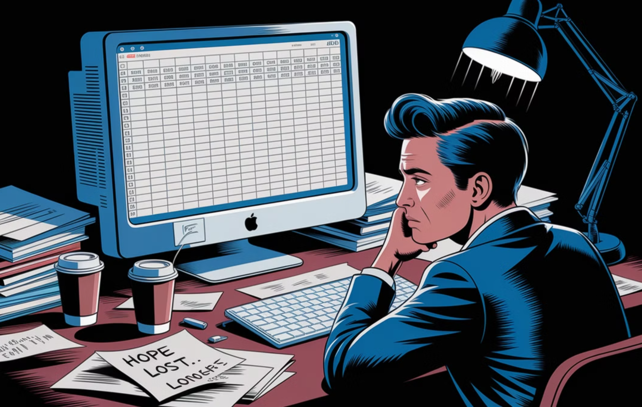
Putting People Over Profit
The real cost of layoffs goes beyond spreadsheets. It's the loss of trust, morale, and dignity. Let's start valuing people over profit.

Slide 8
Let's Drive Change
Have you or someone you know been affected by layoffs? Let's talk about how we can make a difference. #Layoffs #WorkplaceCulture #LeadershipMatters

