Slide 1
Medical Billing Outsourcing: Your Practice's Financial Game-Changer
Healthcare providers face mounting challenges in 2025—shrinking reimbursements, complex payer rules, and increasing patient responsibility.
Is your practice struggling with an overwhelmed in-house billing team? Outsourcing could be the strategic solution you need.
kW
by Kimberly Wiethoff

Slide 2
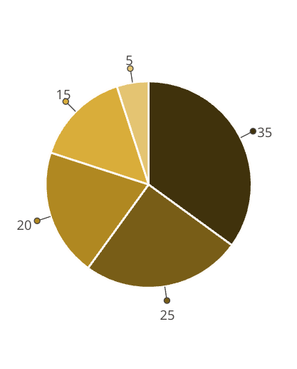
The Financial Reality for Medical Practices
Today's medical practices face unprecedented financial pressures that directly impact profitability and sustainability. These challenges create a complex landscape that practices must navigate effectively to remain viable.
As shown in the chart, shrinking reimbursements represent the largest financial challenge at 35%, creating significant revenue pressure on practices of all sizes. Constantly changing payer rules (25%) require continuous staff training and claim adjustments, while growing patient responsibility (20%) increases collection complexities and potential bad debt.
Shrinking Reimbursements
Changing Payer Rules
Growing Patient Responsibility
Staffing challenges (15%) include high turnover rates and difficulty finding qualified billing specialists in today's competitive market. Meanwhile, the ongoing investment in technology (5%) remains necessary but creates additional financial strain as practices try to keep pace with industry requirements.
Staffing Challenges
Technology Costs
These combined factors create a perfect storm for medical practices that lack specialized billing expertise or adequate resources—highlighting why many are reconsidering their approach to revenue cycle management.

Slide 3
Cost Savings Through Outsourcing
In-House Expenses
Outsourced Solution
Full-time staff salaries
Single predictable fee
Employee benefits
No employee overhead
Training costs
No technology investments
Software licenses
Scalable as needed
Claims management tools
No compliance update costs

Slide 4
Improved Claim Accuracy & Faster Payments
Clean Claims
First-Pass Acceptance
Faster Processing
Improved Cash Flow
Professional coders ensure proper documentation and coding.
Timely submission accelerates reimbursement cycles.
Consistent revenue stream supports practice operations.
Higher clean claim rates mean fewer rejections.

Slide 5
Expert Knowledge & Advanced Technology
Coding Expertise
Certified specialists stay current with ICD and CPT updates.
Payer Rule Mastery
Experts navigate complex and frequently changing requirements.
Compliance Assurance
Teams remain updated on regulations to prevent penalties.
Advanced Analytics
Powerful reporting tools identify revenue opportunities.

Slide 6
Real-World Technology Advantages
Robust Analytics
Automation Tools
Advanced reporting identifies revenue improvement opportunities.
AI-powered solutions detect errors before submission.
Cloud Integration
Security Compliance
Seamless connections with your existing EHR system.
HIPAA-compliant systems protect sensitive patient data.

Slide 7
More Time for Patient Care
36%
42%
Staff Time Saved
Reduced Burnout
Hours redirected from billing tasks to patient interactions
Decrease in administrative stress among clinical staff
28%
Improved Satisfaction
Increase in patient satisfaction scores with more attention

Slide 8
Business Adaptability & Growth
Scale Efficiently
Adjust billing capacity as your practice grows.
Add Providers
Seamlessly integrate new clinicians without billing disruption.
Open Locations
Expand to multiple sites with consistent billing processes.
Diversify Services
Add specialties with billing support already in place.

Slide 9
The Implementation Process
Partnership Agreement
Select the right billing partner for your specialty.
System Integration
Connect your EHR with the billing system.
Staff Training
Learn new workflows and communication processes.
Performance Monitoring
Track improvements in collections and denials.

Slide 10
Selecting Your Ideal Billing Partner
Strategic Partnership
A true revenue cycle advisor, not just a service vendor.
Performance Metrics
Transparent reporting and accountability for results.
Specialty Experience
Deep knowledge of your specific medical field.
Responsive Communication
Dedicated account manager and support team.

Slide 11
Real Results From Practices Like Yours
98.7% clean claim rate for cardiology group
14-day average payment time for pediatric practice
$247,000 additional revenue for orthopedic clinic
Reduced denials by 42% in first quarter after switch.
Down from 32 days with previous in-house billing.
Recovered through proper coding and denial management.

Slide 12
Position Your Practice for Success in 2025
Assess Current Performance
Review key metrics like days in A/R, denial rates, and collection ratios.
Request Vendor Proposals
Get detailed quotes from 3-5 medical billing specialists.
Plan Implementation Timeline
Create a 60-90 day transition schedule to prevent disruption.
Measure Ongoing Success
Track improvements in revenue, staff satisfaction, and patient care.

