Slide 1
Understanding Telehealth Billing in 2025
Telehealth has evolved from a pandemic necessity to an essential component of healthcare delivery. As virtual care becomes increasingly integrated into medical practice, the billing landscape has grown more complex with evolving payer policies, CPT updates, and varying state regulations.
This presentation provides healthcare providers, billers, and administrators with comprehensive guidance on navigating telehealth billing in 2025, ensuring you can maximize reimbursement while maintaining compliance with the latest requirements.
kW
by Kimberly Wiethoff

Slide 2
The Evolution of Telehealth
Pre-2020
Limited telehealth adoption with significant reimbursement restrictions and primarily rural focus. Few permanent coverage options existed outside of demonstration programs.
2020-2022
Explosive growth during public health emergency with temporary waivers enabling widespread coverage. Healthcare delivery transformed virtually overnight.
2023-2024
Transition period with gradual codification of permanent telehealth policies. Many temporary provisions extended while gathering outcomes data.
2025
Mature telehealth ecosystem with established reimbursement pathways, though complexity remains across payers and service types.
This rapid evolution has created a patchwork of policies that requires vigilant tracking. Understanding this historical context helps explain why today's telehealth billing environment contains seemingly contradictory elements.

Slide 3
CMS and Commercial Payer Guidelines
Medicare/CMS
Commercial Payers
Medicaid
CMS maintains three categories of telehealth services: permanent, temporary during PHE plus 151 days, and temporary under evaluation. Review the Medicare Telehealth Services List quarterly for changes to service coverage status.
Policies vary significantly between insurers. United Healthcare, Aetna, Cigna, and BCBS each maintain different telehealth service lists and documentation requirements. Some commercial payers now offer enhanced reimbursement for quality-focused telehealth programs.
State Medicaid programs operate independently with unique telehealth policies. Coverage ranges from comprehensive to limited, with some states requiring payment parity between in-person and virtual visits.
Create a payer matrix that details each insurer's telehealth policies, including covered services, required modifiers, and documentation specifications. This reference tool should be updated quarterly as payer policies evolve.

Slide 4
Place of Service Codes and Modifiers
POS Codes
Modifiers
POS 02: Telehealth Provided Other Than in Patient's Home
Modifier 95: Synchronous telehealth via real-time audio/video
POS 10: Telehealth Provided in Patient's Home
Modifier GT: Via interactive telecommunications systems (some payers)
POS 11: Only for in-office visits (not telehealth)
Modifier FQ: Audio-only telehealth service
Using incorrect POS codes is the #1 reason for telehealth claim denials in 2025.
Modifier FR: Supervising practitioner was present through telehealth
Many telehealth claims require both the appropriate POS code AND modifier. For example, a synchronous video visit conducted with a patient at home would typically be coded as POS 10 with modifier 95. Always verify payer-specific requirements.

Slide 5
Documentation Requirements
Patient Consent
Document informed consent specifically for telehealth, including discussion of limitations, privacy considerations, and alternatives. Must be obtained before service delivery.
Technology Details
Record the specific platform used, whether audio-visual or audio-only, and any technical issues that affected care delivery.
Location Information
Document patient location at time of service (state and setting) and provider location. This addresses licensing requirements and determines applicable regulations.
Time and Medical Necessity
Note exact start and end times, total duration, and clear justification for why the service was medically necessary via telehealth.
Despite being virtual, telehealth documentation must meet or exceed in-person standards. Audits of telehealth claims have increased significantly in 2025, making robust documentation essential for compliance.

Slide 6
Eligible Telehealth Services
E/M Services
Behavioral Health
Includes office visits, hospital follow-ups, and consultations. Time-based coding often more appropriate than complexity for telehealth.
Most comprehensively covered telehealth specialty with few restrictions. Includes psychotherapy, medication management, and substance use treatment.
Chronic Care
Remote monitoring, chronic care management, and principal care management codes frequently allowed via telehealth.
Ineligible Services
Procedures requiring physical contact, most diagnostic imaging, and certain complex examinations remain ineligible.
Physical Therapy
Select therapeutic exercises, evaluations, and education services permitted virtually, though with more restrictions than other categories.
CMS publishes an updated list of approved telehealth services quarterly. Commercial payers typically cover similar services but may include additional categories or restrictions. Always verify coverage before rendering services.

Slide 7
Licensing and Geographic Requirements
Patient Location Verification
Confirm and document where patient is physically located during each telehealth encounter
License Requirements
Ensure provider is licensed in patient's physical location
Interstate Compacts
Utilize interstate licensure compacts when available
Practice Standards
Comply with state-specific practice regulations
In 2025, 36 states participate in the Interstate Medical Licensure Compact, which expedites licensing for physicians practicing across state lines. However, each state maintains unique telehealth practice standards beyond licensing that must be followed. Geographic restrictions remain one of the most complex aspects of telehealth compliance.

Slide 8
Technology and HIPAA Compliance
HIPAA-Compliant Platforms
Authentication Requirements
Only use telehealth platforms with signed Business Associate Agreements (BAAs) that provide end-to-end encryption and secure data storage. Popular compliant options include Zoom for Healthcare, Doxy.me Premium, and Epic Telehealth.
Implement multi-factor authentication for provider access and robust patient identity verification protocols. Document identity verification process in each encounter note.
Audit Trails
Privacy Notices
Maintain comprehensive audit logs of all telehealth sessions, including connection times, participants, and any technical issues. These logs are increasingly requested during payer audits.
Update Notice of Privacy Practices to specifically address telehealth services and obtain acknowledgment from patients before their first virtual visit.
The temporary waivers that allowed non-HIPAA compliant communication tools during the public health emergency have expired. All telehealth services must now be delivered through fully compliant platforms with appropriate security safeguards.

Slide 9
Audio-Only Telehealth Considerations
Limited Eligibility
Only specific services qualify for audio-only coverage
Special Documentation
Must document reason video wasn't possible
Proper Coding
Requires FQ modifier with appropriate POS
Payer Verification
Confirm coverage before service delivery
Audio-only telehealth remains a crucial access point for patients with technology limitations or in areas with insufficient broadband. Medicare continues to cover audio-only services for mental health and substance use disorders when video capability is unavailable. Most commercial payers have more restricted policies, often limiting audio-only coverage to brief check-ins or rural areas.
When billing audio-only services, always document why video wasn't feasible (patient limitation, technology barrier, etc.) to support medical necessity.

Slide 10
Remote Patient Monitoring Billing
99453
99454
Initial Setup
Device Supply
One-time code for setting up remote monitoring equipment and patient education
Monthly code for providing equipment and transmission services
99457
99458
First 20 Minutes
Additional Time
Monthly management and interpretation of data, minimum 20 minutes
Each additional 20 minutes beyond the initial period
Remote Patient Monitoring (RPM) has emerged as a distinct reimbursement category separate from traditional telehealth services. Unlike general telehealth visits, RPM codes are not subject to the same geographic restrictions and can be billed for patients in any location.
To qualify for RPM billing, devices must automatically transmit patient physiologic data (not self-reported) at least 16 days per 30-day period. Documentation must include time spent reviewing and interpreting data, any resulting care plan modifications, and communication with the patient or caregiver.

Slide 11
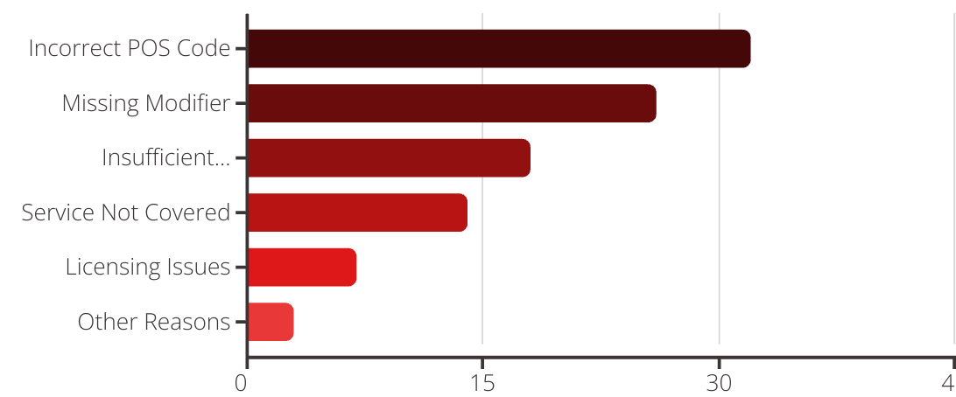
Common Billing Pitfalls
Analysis of 2024 telehealth claim denials reveals that technical coding errors account for the majority of rejected claims. Incorrect place of service codes remain the leading cause of denials, followed by missing or inappropriate modifiers.
Implementing a telehealth-specific claim review process can significantly reduce these preventable errors. Consider using automated claim scrubbers that verify telehealth coding requirements before submission and conduct regular audits of telehealth documentation to identify compliance gaps.

Slide 12
Telehealth Reimbursement Optimization
Implement Pre-Visit Verification
Streamline Documentation
Develop a process to verify insurance coverage, telehealth benefits, copay/coinsurance amounts, and applicable state regulations before each virtual visit. This proactive approach dramatically reduces denials and improves patient financial experience.
Conduct Payer Analysis
Create telehealth-specific templates that prompt providers to include all required elements for compliant billing. These should incorporate technical details, consent verification, and medical necessity justification while maintaining efficiency in documentation.
Systematically compare reimbursement rates for telehealth services across your payer mix. Identify which payers offer the best rates for virtual care and which have the most restrictive policies. This data should inform contracting negotiations and service expansion decisions.
Organizations that have implemented comprehensive telehealth revenue cycle optimization report an average 23% increase in collection rates and 35% reduction in days in accounts receivable compared to non-optimized practices.

Slide 13
Future of Telehealth Billing
Value-Based Telehealth
AI-Enhanced Documentation
Movement toward outcome-based reimbursement rather than fee-for-service telehealth models
Automated compliance tools that ensure telehealth documentation meets all regulatory requirements
Expanded Service Eligibility
Regulatory Standardization
Growing list of services approved for virtual delivery with appropriate reimbursement
Increasing alignment of telehealth policies across payers and state lines
The telehealth billing landscape continues to evolve rapidly. Organizations that invest in flexible billing systems, regular staff training, and proactive policy monitoring will be best positioned to maximize telehealth revenue opportunities while maintaining compliance.
As we move toward more standardized telehealth billing frameworks, stay engaged with industry associations and advocacy efforts that shape telehealth reimbursement policy. Your input can help create a more sustainable telehealth ecosystem for providers and patients alike.

